Slide 1
TRANSLATION

Slide 2
Translation is the RNA directed synthesis of polypeptides (proteins). This process requires all three classes of RNA.
Although the chemistry of peptide bond formation is relatively simple, the processes leading to the ability to form a peptide bond are exceedingly complex.
The template for correct addition of individual amino acids is the mRNA, yet both tRNAs and rRNAs are involved in the process.
The tRNAs carry activated amino acids into the ribosome which is composed of rRNA and ribosomal proteins. The ribosome is associated with the mRNA ensuring correct access of activated tRNAs and containing the necessary enzymatic activities to catalyze peptide bond formation.

Slide 3
Translation refers to the process of polymerisation of amino acids to form a polypeptide. The order and sequence of amino acids are defined by the sequence of bases in the mRNA.
The amino acids are joined by a bond which is known as a peptide bond. Formation of a peptide bond requires energy.
Therefore, in the first phase itself amino acids are activated in the presence of ATP and linked to their cognate tRNA–a process commonly called as charging of tRNA or aminoacylation of tRNA to be more specific.
If two such charged tRNAs are brought close enough, the formation of peptide bond between them would be favoured energetically. The presence of a catalyst would enhance the rate of peptide bond formation. The cellular factory responsible for synthesising proteins is the ribosome.

Slide 4
The ribosome consists of structural RNAs and about 80 different proteins.
In its inactive state, it exists as two subunits; a large subunit and a small subunit. When the small subunit encounters an mRNA, the process of translation of the mRNA to protein begins.
There are two sites in the large subunit, for subsequent amino acids to bind to and thus, be close enough to each other for the formation of a peptide bond.
The ribosome also acts as a catalyst (23S rRNA in bacteria is the enzyme- ribozyme) for the formation of peptide bond.

Slide 5
A translational unit in mRNA is the sequence of RNA that is flanked by the start codon (AUG) and the stop codon and codes for a polypeptide.
An mRNA also has some additional sequences that are not translated and are referred as untranslated regions (UTR). The UTRs are present at both 5' -end (before start codon) and at 3' -end (after stop codon). They are required for efficient translation process.
For initiation, the ribosome binds to the mRNA at the start codon (AUG) that is recognised only by the initiator tRNA. The ribosome proceeds to the elongation phase of protein synthesis. During this stage, complexes composed of an amino acid linked to tRNA, sequentially bind to the appropriate codon in mRNA by forming complementary base pairs with the tRNA anticodon. The ribosome moves from codon to codon along the mRNA. Amino acids are added one by one, translated into Polypeptide sequences dictated by DNA and represented by mRNA. At the end, a release factor binds to the stop codon, terminating translation and releasing the complete polypeptide from the ribosome.

Slide 6
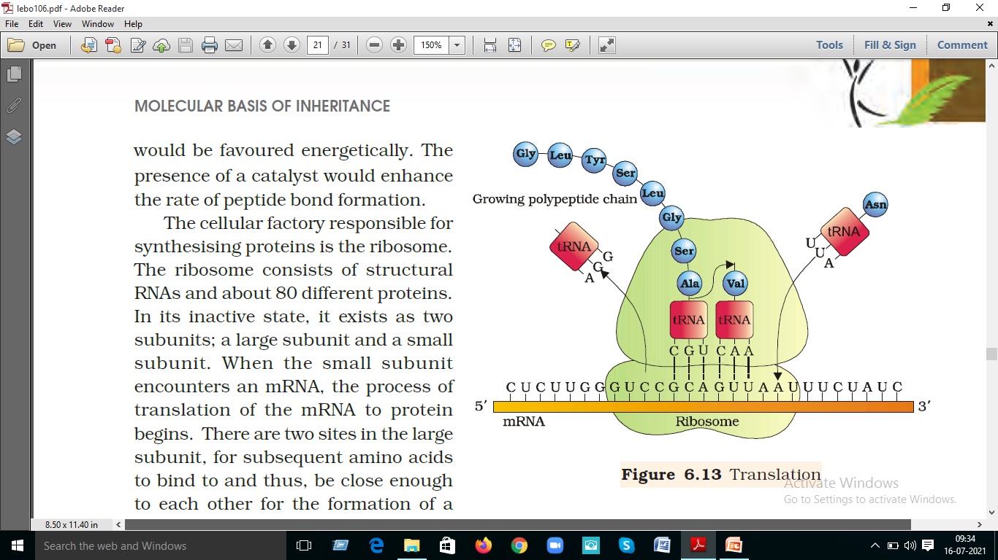

Slide 7
Protein synthesis – Translation
The process by which the mRNA codes for a particular protein is known as Translation. In the process, the ribosome translates the mRNA produced from DNA into a chain of specific amino acids. This chain of amino acids leads to protein synthesis. It is a process where the expense of ATP is required and this energy is given by the charged tRNA. The whole machinery of translation is present in the ribosomes.
The ribosomes consist of a bigger subunit and a smaller subunit. The larger subunit, in turn, consists of two molecules of tRNA that are placed close so that peptide bond could be developed at the expense of sufficient energy. The mRNA enters the smaller subunit which is held by the molecules of tRNA of the complementary codon, that exists in the bigger subunit. Hence, two codons are held by two molecules of tRNA, placed near to each other and a peptide bond is produced among them. When this process repeats, a large chain of amino acids is synthesized. At the stop, codon ribosome releases the amino acid chain.

Slide 8
Activation of Amino Acids
Activation of amino acids is carried out by a two step process catalyzed by aminoacyl-tRNA synthetases. Humans express both nuclear genome and mitochondrial genome encoded aminoacyl-tRNA synthetases. The aminoacyl-tRNA synthetases are divided into two classes: class I and class II. The class I enzymes catalyze addition of the amino acid to the 2′-OH of a target tRNA and do so as either monomeric or dimeric enzymes. The class II enzymes catalyze addition of the amino acid to the 3′-OH of a target tRNA and do so as dimeric or tetrameric enzymes. Humans express 19 class I aminoacyl-tRNA synthetases of which 8 are mitochondrial genes. Humans express 19 class II aminoacyl-tRNA synthetase genes which includes two genes that encode the two subunits (α and β) of a phenylalanine-tRNA synthetase and 8 mitochondrial synthetase genes.
Activation of amino acids requires energy in the form of ATP and occurs in a two step reaction catalyzed by the aminoacyl-tRNA synthetases. First the enzyme attaches the amino acid to the α-phosphate of ATP with the concomitant release of pyrophosphate (PP_{i}). This is termed an aminoacyl-adenylate (aminoacyl-AMP) intermediate. In the second step the enzyme catalyzes transfer of the amino acid to either the 2’–OH (class I enzymes) or 3’–OH (class II enzymes) of the ribose portion of the 3′-terminal adenosine residue of the tRNA generating the activated aminoacyl-tRNA. Although these reactions are freely reversible, the forward reaction is favored by the coupled hydrolysis of PP_{i}.

Slide 9
Order of Events in Translation
The ability to begin to identify the roles of the various ribosomal proteins in the processes of ribosome assembly and translation was aided by the discovery that the ribosomal subunits will self assemble in vitro from their constituent parts.
Following assembly of both the small and large subunits onto the mRNA, and given the presence of charged tRNAs, protein synthesis can take place. To reiterate the process of protein synthesis:
Synthesis proceeds from the N-terminus to the C-terminus of the protein
The ribosomes “read” the mRNA in the 5′ to 3′ direction
Active translation occurs on polyribosomes (also termed polysomes). This means that more than one ribosome can be bound to and translate a given mRNA at any one time
Active translation occurs on polyribosomes (also termed polysomes). This means that more than one ribosome can be bound to and translate a given mRNA at any one time
Translation proceeds in an ordered process. First accurate and efficient initiation occurs, then chain elongation, and finally accurate and efficient termination must occur. All three of these processes require specific proteins, some of which are ribosome associated and some of which are separate from the ribosome, but may be temporarily associated with it.

Slide 10
Initiation
Initiation of translation in both prokaryotes and eukaryotes requires a specific initiator tRNA, tRNA_{i}^{met}, that is used to incorporate the initial methionine residue into all proteins. In E. coli a specific version of tRNA_{i}^{met} is required to initiate translation, [tRNA_{i}^{fmet}]. The methionine attached to this initiator tRNA is formylated. Formylation requires N¹⁰-formy-THF and is carried out after the methionine is attached to the tRNA. The fmet-tRNA_{i}^{fmet} still recognizes the same codon, AUG, as regular tRNA^{met}. Although tRNA_{i}^{met} is specific for initiation in eukaryotes it is not a formylated tRNA^{met}.
The initiation of translation requires recognition of an AUG codon. In the polycistronic prokaryotic RNAs this AUG codon is located adjacent to a Shine-Dalgarno element in the mRNA. The Shine-Dalgarno element is recognized by complimentary sequences in the small subunit rRNA (16S in E. coli).
In eukaryotes, initiator AUGs are generally, but not always, the first encountered by the translational machinery. A specific sequence context, surrounding the initiator AUG, aids ribosomal discrimination. This context is ^{A}/_{G}CC^{A}/_{G}CCAUG^{A}/_{G} in most mRNAs and is referred to as the Kozak consensus sequence.

Slide 11
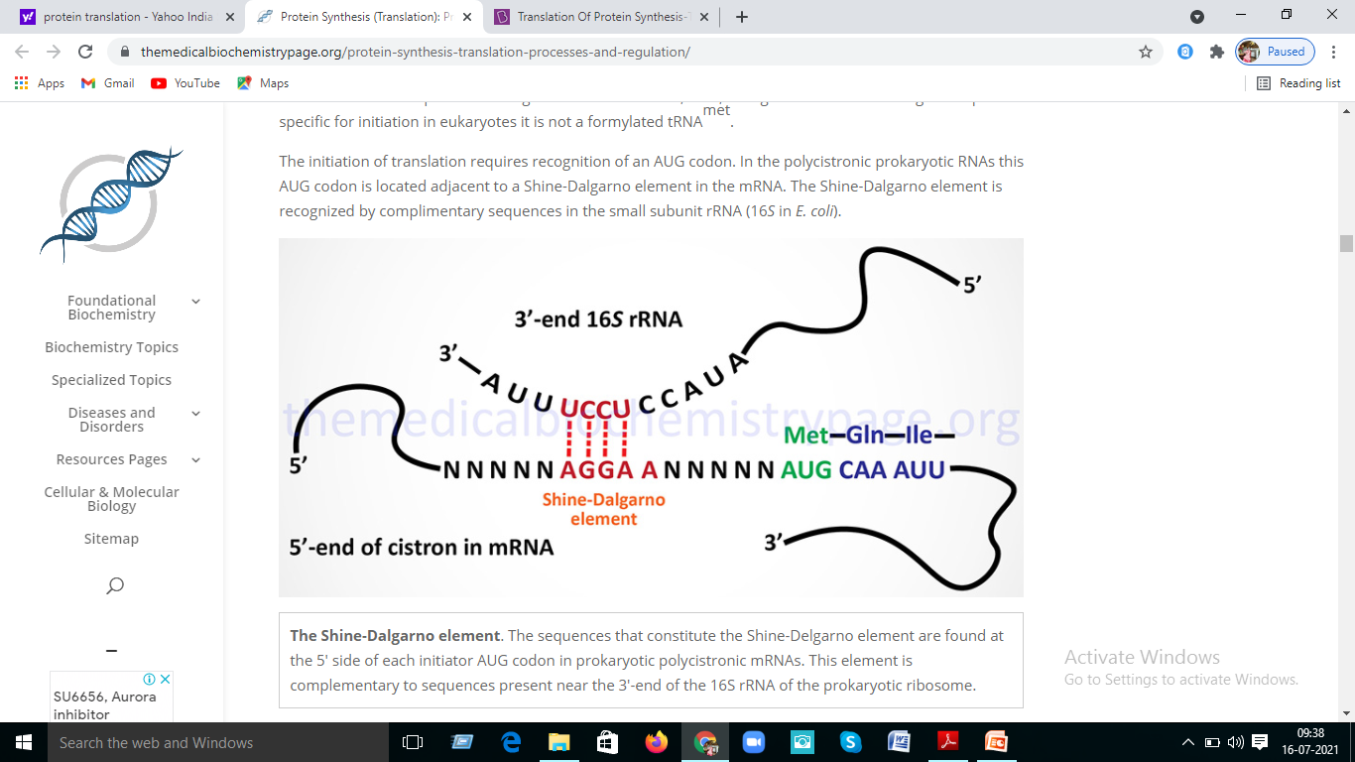

Slide 12
Eukaryotic Initiation Factors and Their Functions
The specific non-ribosome-associated proteins required for accurate translational initiation are termed initiation factors. In E. coli they are IFs in eukaryotes they are eIFs. Numerous eIFs have been identified.
Current research has shown that the mammalian eIF family of protein complexes consists of at least 12 members that together consist of at least 29 distinct proteins. By far the largest eIF complex is the eIF-3 complex (described in the next section) which contains 13 protein subunits and has an overall mass of >800 kDa.
Specific Steps in Translational Initiation
Initiation of translation requires 4 specific steps:
1. A ribosome must dissociate into its’ 40S and 60S subunits.
2. A ternary complex termed the pre-initiation complex is formed consisting of the initiator, GTP, eIF-2 and the 40S subunit.
3. The mRNA is bound to the pre-initiation complex.
4. The 60S subunit associates with the pre-initiation complex to form the 80S initiation complex.

Slide 13
Elongation
The process of elongation, like that of initiation requires specific non-ribosomal proteins. In prokaryotes these are designated EFs and in eukaryotes, eEFs.
Elongation of polypeptides occurs in a cyclic manner such that at the end of one complete round of amino acid addition the A site will be empty and ready to accept the incoming aminoacyl-tRNA dictated by the next codon of the mRNA. This means that not only does the incoming amino acid need to be attached to the peptide chain but the ribosome must move down the mRNA to the next codon.
Each incoming aminoacyl-tRNA is brought to the ribosome by an eEF-1α-GTP complex. When the correct tRNA is deposited into the A site the GTP is hydrolyzed and the eEF-1α-GDP complex dissociates. In order for additional translocation events the GDP must be exchanged for GTP. This is carried out by eEF-1βγ similarly to the GTP exchange that occurs with eIF-2 catalyzed by eIF-2B.
The peptide attached to the tRNA in the P site is transferred to the amino group at the aminoacyl-tRNA in the A site forming a new peptide bond. This reaction is catalyzed by peptidyltransferase activity which resides in what is termed the peptidyltransferase center (PTC) of the large ribosomal subunit (60S subunit). This enzymatic process is termed transpeptidation. This enzymatic activity is not mediated by any ribosomal proteins but instead by the large ribosomal RNA (28S) contained in the 60S subunit. This RNA encoded enzymatic activity is referred to as a ribozyme.
The elongated peptide now resides on a tRNA in the A site. The A site needs to be freed in order to accept the next aminoacyl-tRNA. The process of moving the peptidyl-tRNA from the A site to the P site is termed, translocation. Translocation is catalyzed by eEF-2 coupled to GTP hydrolysis. In the process of translocation the ribosome is moved along the mRNA such that the next codon of the mRNA resides under the A site. Following translocation eEF-2 is released from the ribosome. The cycle can now begin again.

Slide 14
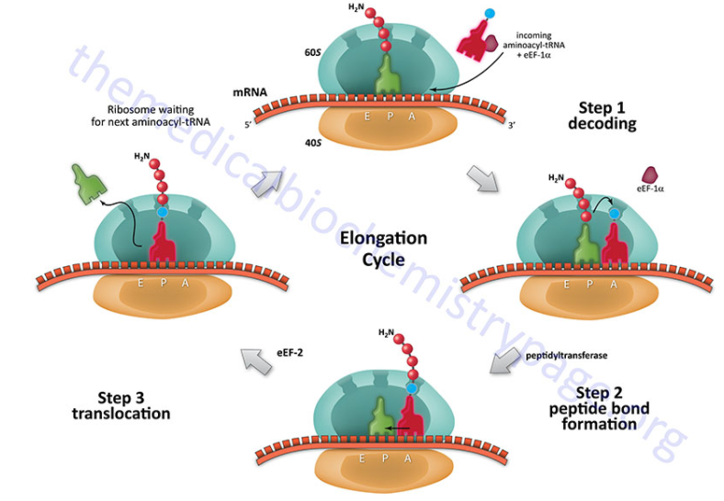

Slide 15
Termination
Like initiation and elongation, translational termination requires specific protein factors identified as releasing factors, RFs in E. coli and eRFs in eukaryotes.
There are 2 RFs in E. coli and one in eukaryotes. The signals for termination are the same in both prokaryotes and eukaryotes. These signals are termination codons present in the mRNA. There are 3 termination codons, UAG, UAA and UGA.
In E. coli the termination codons UAA and UAG are recognized by RF-1, whereas RF-2 recognizes the termination codons UAA and UGA. The eRF binds to the A site of the ribosome in conjunction with GTP.
The binding of eRF to the ribosome stimulates the peptidyltransferase activity to transfer the peptidyl group to water instead of an aminoacyl-tRNA. The resulting uncharged tRNA left in the P site is expelled with concomitant hydrolysis of GTP. The inactive ribosome then releases its mRNA and the 80S complex dissociates into the 40S and 60S subunits ready for another round of translation.

