Slide 1
ENZYMES

Slide 2
Enzymes are biocatalysts – the catalysts of life. A catalyst is defined as a substance that increases the velocity or rate of a chemical reaction without itself undergoing any change in the overall process.
Enzymes may be defined as biocatalysts synthesized by living cells. They are protein in nature (exception – RNA acting as ribozyme), colloidal and thermolabile in character, and specific in their action.
In the laboratory, hydrolysis of proteins by a strong acid at 100°C takes at least a couple of days. The same protein is fully digested by the enzymes in gastrointestinal tract at body temperature (37°C) within a couple of hours.
This remarkable difference in the chemical reactions taking place in the living system is exclusively due to enzymes. The very existence of life is unimaginable without the presence of enzymes.

Slide 3
Berzelius in 1836 coined the term catalysis
(Greek : to dissolve). In 1878, Kuhne used the
word enzyme (Greek : in yeast) to indicate the catalysis taking place in the biological systems.
Since 1964, the IUB system of enzyme
classification has been in force. Enzymes are
divided into six major classes

Slide 4
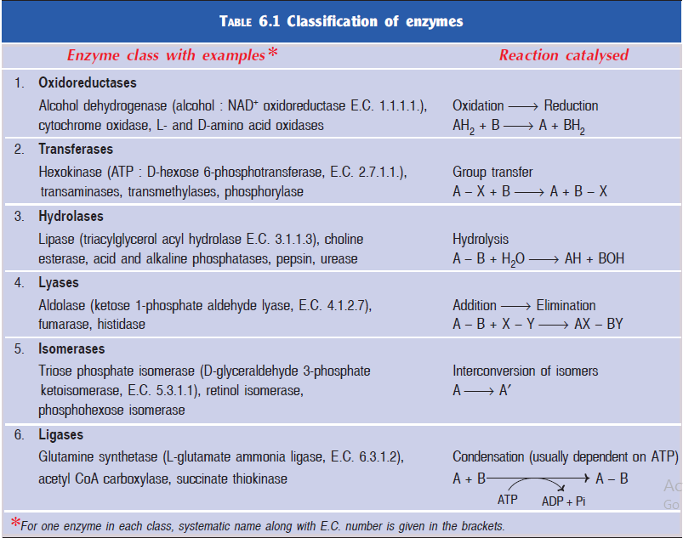

Slide 5
1. Oxidoreductases : Enzymes involved in oxidation-reduction reactions.
2. Transferases : Enzymes that catalyse the transfer of functional groups.
3. Hydrolases : Enzymes that bring about hydrolysis of various compounds.
4. Lyases : Enzymes specialised in the addition or removal of water, ammonia, CO2 etc.
5. Isomerases : Enzymes involved in all the isomerization reactions.
6. Ligases : Enzymes catalysing the synthetic reactions (Greek : ligate—to bind) where two molecules are joined together and ATP is used.

Slide 6
All the enzymes are invariably proteins. In recent years, however, a few RNA molecules have been shown to function as enzymes. Each enzyme has its own tertiary structure and specific conformation which is very essential for its catalytic activity. The functional unit of the enzyme is known as holoenzyme which is often made up of apoenzyme (the protein part) and a coenzyme (non-protein organic part).
Holoenzyme =Apoenzyme + Coenzyme (active enzyme) (protein part) (non-protein part)
The term prosthetic group is used when the non-protein moiety tightly (covalently) binds with the apoenzyme. The coenzyme can be separated by dialysis from the enzyme while the prosthetic group cannot be. The word monomeric enzyme is used if it is made up of a single polypeptide e.g. ribonuclease, trypsin. Some of the enzymes which possess more than one polypeptide (subunit) chain are known as oligomeric enzymes e.g. lactate dehydrogenase, aspartate transcarbamoylase etc. There are certain multienzyme complexes possessing specific sites to catalyse different reactions in a sequence.

Slide 7
Factors affecting enzyme activity
1. Concentration of enzyme
As the concentration of the enzyme is increased, the velocity of the reaction proportionately increases.
In fact, this property of enzyme is made use in determining the serum enzymes for the diagnosis of diseases.
By using a known volume of serum, and keeping all the other factors (substrate, pH, temperature etc.) at the optimum level, the enzyme could be assayed in the laboratory.

Slide 8
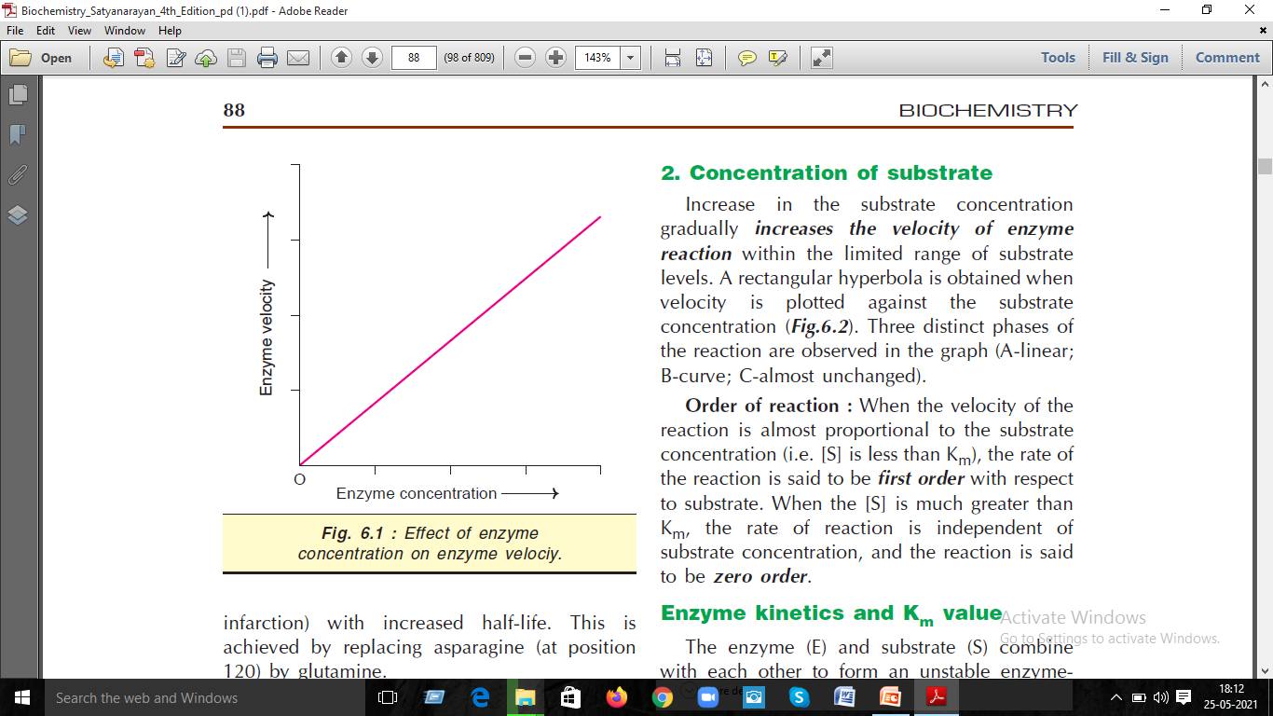

Slide 9
2. Concentration of substrate
Increase in the substrate concentration gradually increases the velocity of enzyme reaction within the limited range of substrate levels. A rectangular hyperbola is obtained when velocity is plotted against the substrate concentration.
Order of reaction : When the velocity of the reaction is almost proportional to the substrate concentration (i.e. [S] is less than Km), the rate of the reaction is said to be first order with respect to substrate. When the [S] is much greater than Km, the rate of reaction is independent of substrate concentration, and the reaction is said to be zero order.

Slide 10
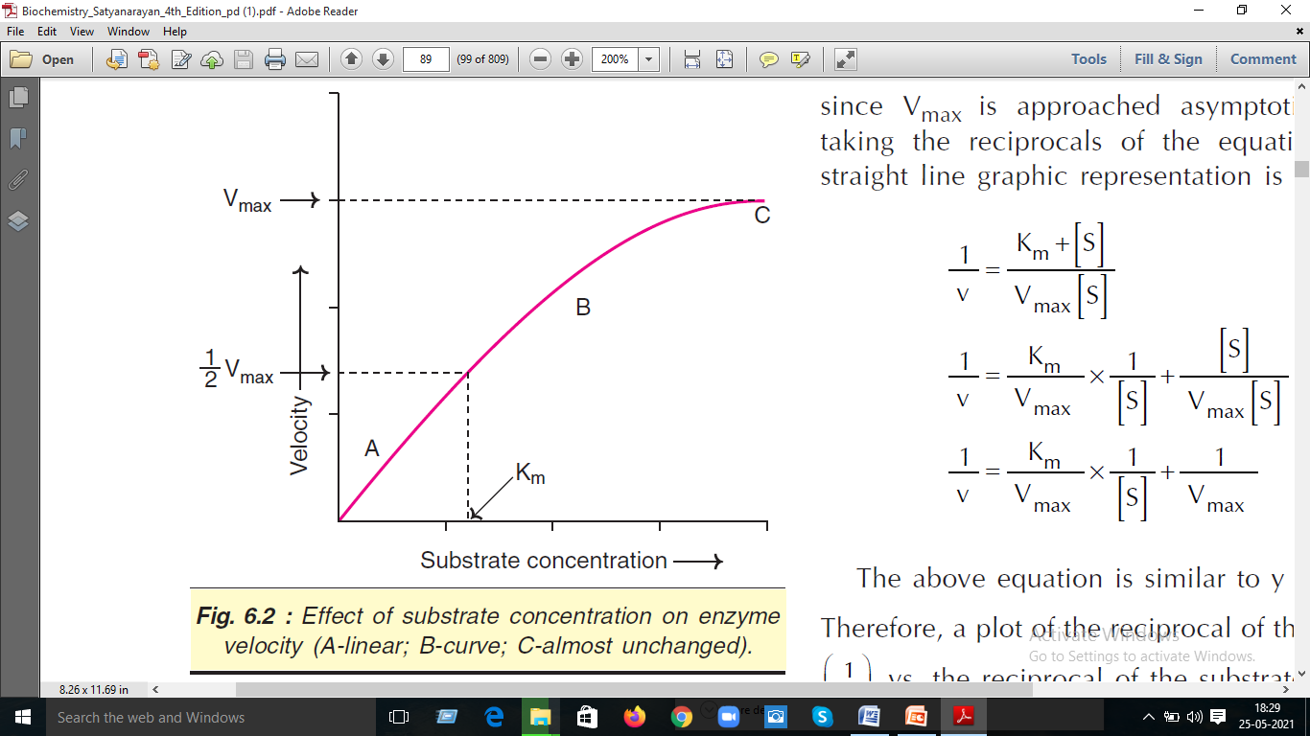

Slide 11
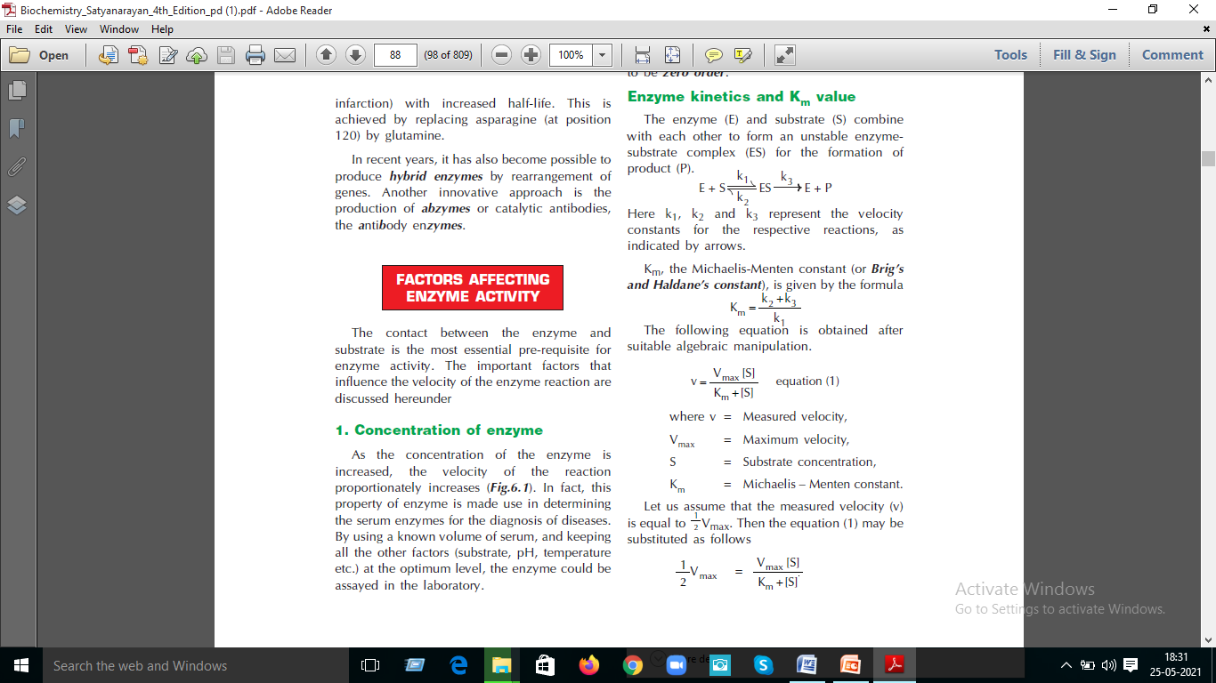

Slide 12
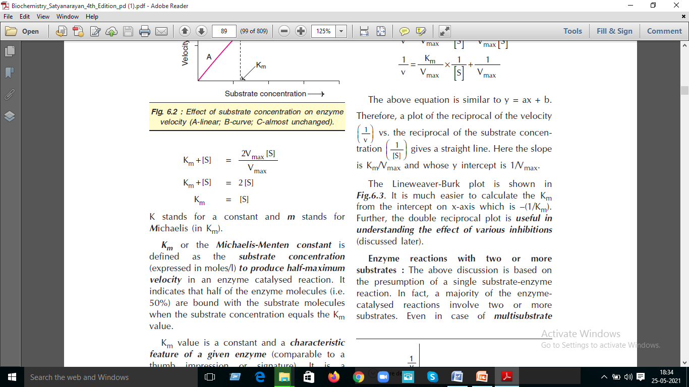
K stands for a constant and m stands for Michaelis (in Km).
Km or the Michaelis-Menten constant is defined as the substrate concentration (expressed in moles/l) to produce half-maximu velocity in an enzyme catalysed reaction. It indicates that half of the enzyme molecules (i.e 50%) are bound with the substrate molecule when the substrate concentration equals the Km
Value Km value is a constant and a characteristic feature of a given enzyme (comparable to a thumb impression or signature). It is a representative for measuring the strength of ES complex. A low Km value indicates a strong affinity between enzyme and substrate, whereas a high Km value reflects a weak affinity between them. For majority of enzymes, the Km values are in the range of 10–5 to 10–2 moles. It may however, be noted that Km is not dependent on the concentration of enzyme.

Slide 13
3. Effect of temperature
Velocity of an enzyme reaction increases withmincrease in temperature up to a maximum and then declines. A bell-shaped curve is usually observed.
Temperature coefficient or Q10 is defined as increase in enzyme velocity when the temperature is increased by 10°C. For a majority of enzymes, Q10 is 2 between 0°C and 40°C. Increase in temperature results in higher activation energy of the molecules and more molecular (enzyme and substrate) collision and interaction for the reaction to proceed faster.
The optimum temperature for most of the enzymes is between 35°C–40°C. However, a few enzymes (e.g. Taq DNA polymerase, muscle adenylate kinase) are active even at 100°C. Some plant enzymes like urease have optimum activity around 60°C. This may be due to very stable structure and conformation of these enzymes.
In general, when the enzymes are exposed to a temperature above 50°C, denaturation leading to derangement in the native (tertiary) structure of the protein and active site are seen. Majority of the enzymes become inactive at higher temperature (above 70°C).

Slide 14
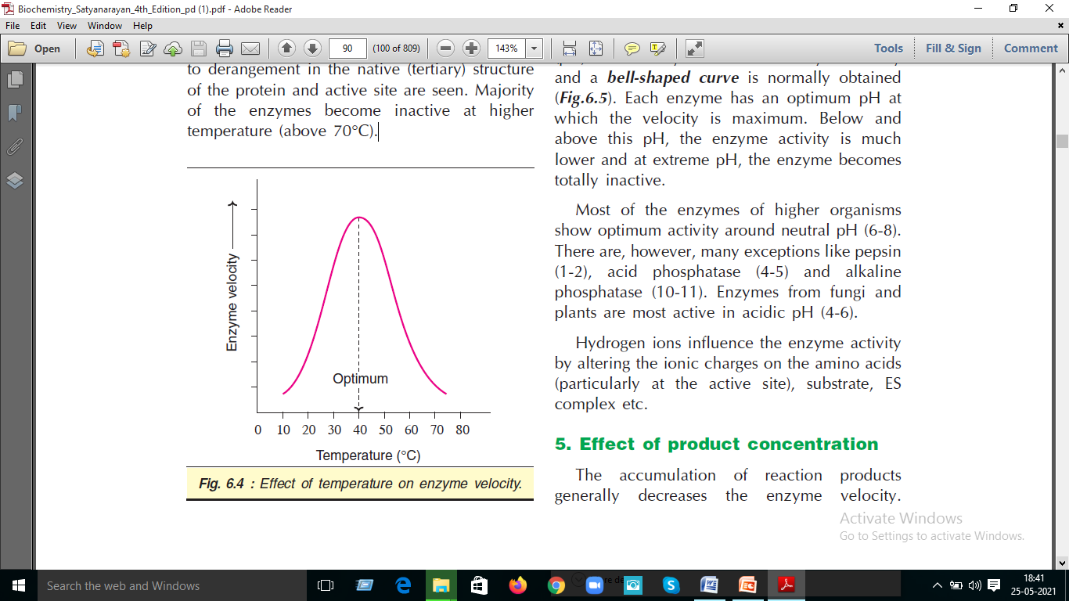

Slide 15
4. Effect of pH
Increase in the hydrogen ion concentration (pH) considerably influences the enzyme activity and a bell-shaped curve is normally obtained .
Each enzyme has an optimum pH at which the velocity is maximum. Below and above this pH, the enzyme activity is much lower and at extreme pH, the enzyme becomes totally inactive.
Most of the enzymes of higher organisms show optimum activity around neutral pH (6-8). There are, however, many exceptions like pepsin (1-2), acid phosphatase (4-5) and alkaline phosphatase (10-11). Enzymes from fungi and plants are most active in acidic pH (4-6).
Hydrogen ions influence the enzyme activity by altering the ionic charges on the amino acids (particularly at the active site), substrate, ES complex etc.

Slide 16
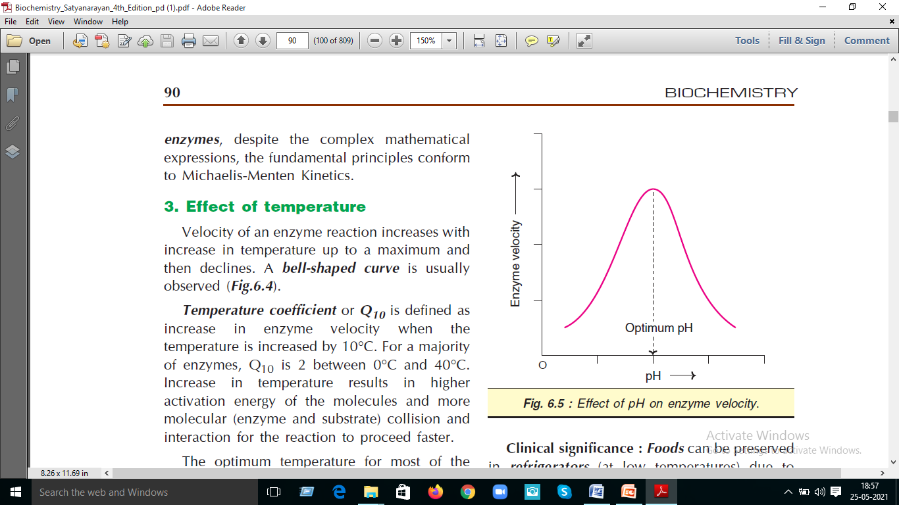

Slide 17
5. Effect of product concentration
The accumulation of reaction products generally decreases the enzyme velocity.
For certain enzymes, the products combine with the active site of enzyme and form a loose complex and, thus, inhibit the enzyme activity.
In the living system, this type of inhibition is generally prevented by a quick removal of products formed.

Slide 18
6. Effect of activators
Some of the enzymes require certain inorganic metallic cations like Mg2+, Mn2+, Zn2+, Ca2+, Co2+, Cu2+, Na+, K+ etc. for their optimum activity. Rarely, anions are also needed for enzyme activity e.g. chloride ion (Cl–) for amylase. Metals function as activators of enzyme velocity through various mechanisms— combining with the substrate, formation of ES-metal complex, direct participation in the reaction and bringing a conformational change in the enzyme.
Two categories of enzymes requiring metals for their activity are distinguished
Metal-activated enzymes : The metal is not tightly held by the enzyme and can be exchanged easily with other ions e.g. ATPase (Mg2+ and Ca2+) Enolase (Mg2+)
Metalloenzymes : These enzymes hold the metals rather tightly which are not readily exchanged. e.g. alcohol dehydrogenase, carbonic anhydrase, alkaline phosphatase, carboxypeptidase and aldolase contain zinc. Phenol oxidase (copper); Pyruvate oxidase (manganese); Xanthine oxidase (molybdenum); Cytochrome oxidase (iron and copper).

Slide 19
7. Effect of time
Under ideal and optimal conditions (like pH, temperature etc.), the time required for an enzyme reaction is less. Variations in the time of the reaction are generally related to the alterations in pH and temperature.
8. Effect of light and radiation
Exposure of enzymes to ultraviolet, beta, gamma and X-rays inactivates certain enzymes due to the formation of peroxides. e.g. UV rays inhibit salivary amylase activity.

Slide 20
Enzymes are big in size compared to substrates which are relatively smaller. Evidently, a small portion of the huge enzyme molecule is directly involved in the substrate binding and catalysis.
The active site (or active centre) of an enzyme represents as the small region at which the substrate(s) binds and participates in the catalysis.

Slide 21
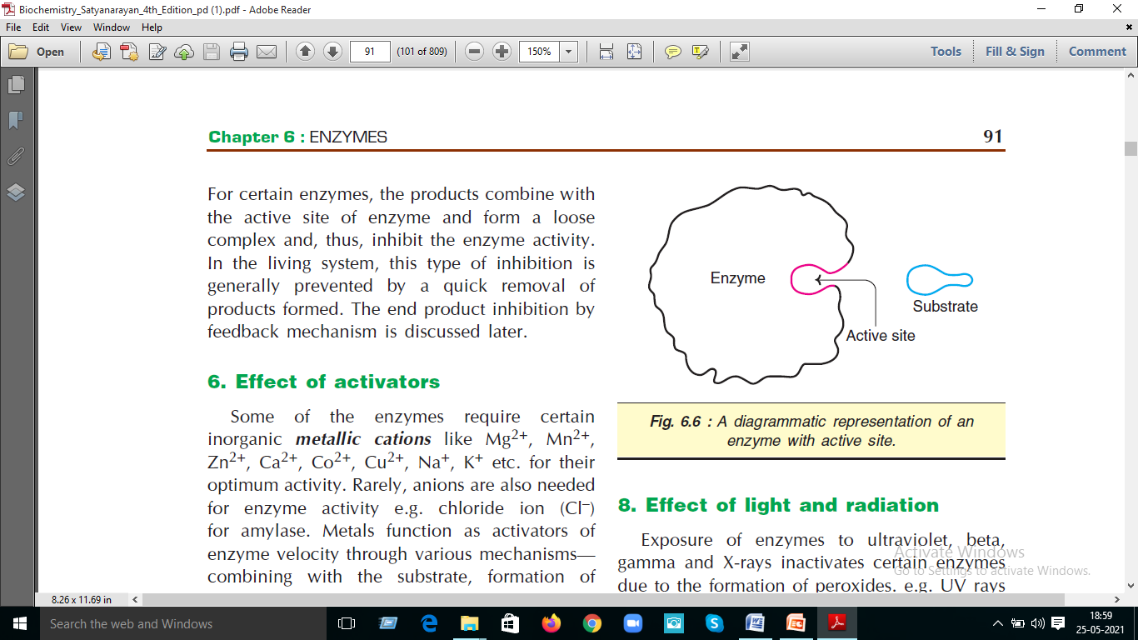

Slide 22
Salient features of active site
1. The existence of active site is due to the tertiary structure of protein resulting in threedimensional native conformation.
2. The active site is made up of amino acids (known as catalytic residues) which are far from each other in the linear sequence of amino acids (primary structure of protein). For instance, the enzyme lysozyme has 129 amino acids.
The active site is formed by the contribution of amino acid residues numbered 35, 52, 62, 63 and 101.
3. Active sites are regarded as clefts or crevices or pockets occupying a small region in a big enzyme molecule.

Slide 23
4. The active site is not rigid in structure and shape. It is rather flexible to promote the specific
substrate binding.
5. Generally, the active site possesses a substrate binding site and a catalytic site. The latter is for the catalysis of the specific reaction.
6. The coenzymes or cofactors on which some enzymes depend are present as a part of the catalytic site.
7. The substrate(s) binds at the active site by weak noncovalent bonds.
8. Enzymes are specific in their function due to the existence of active sites.
9. The commonly found amino acids at the active sites are serine, aspartate, histidine, cysteine, lysine, arginine, glutamate, tyrosine etc.
Among these amino acids, serine is the most frequently found.
10. The substrate[S] binds the enzyme (E) at the active site to form enzyme-substrate complex (ES). The product (P) is released after the catalysis and the enzyme is available for reuse.

