Slide 1



COFFEE
HIMAKSHI BAISHYA
ASSISTANT PROFESSOR, B.VOC, FPT
MANGALDAI COLLEGE

Slide 2

INTRODUCTON
Coffee is a Brewed Drink
Has distinct Aroma & Flavour
Acts as Stimulating Drink
Prepared from Roasted Coffee Beans
Beans are obtained from coffea plant
Coffea plants are cultivated in Over 70 countries
Primarily grown near equatorial regions like Southeast Asia, Americas, Africa, India
Out of many varieties, Two most popular are Coffea arabica & Coffea robusta
Coffee is slightly acidic (pH 5.0 to 5.3) & rich in caffeine content

Slide 3
HISTORY OF COFFEE
Dates back to 12th Century
Originated in Equatorial region of Africa
Then, spread throughout Europe and other continents
According to ancient chronical
Sheikh Omar, who was known for his ability to cure the sick through prayer, was once exiled from Mocha (Yemen) to a desert cave. Starving, Omar chewed berries from nearby shrubbery, but found them to be bitter. He tried roasting the seeds to improve the flavour, but they became hard. He then tried boiling them to soften the seed, which resulted in a fragrant brown liquid. Upon drinking the liquid Omar was revitalized and sustained for days. As stories of this "miracle drug" reached Mocha, Omar was asked to return and was made a saint. From Ethiopia, the coffee plant was introduced into the Arab World through Egypt and Yemen.

Slide 4
HISTORY OF COFFEE
In 15th Century, Coffee beans were first roasted & brewed in Arabia on large scale
By 16th Century, Coffee reached rest of Middle East & Northern America
Coffee Seeds were first exported from Ethiopia to Yemen
Yemeni traders took coffee back to their homeland & began to cultivate the seed
During 16th Century, all exported coffee was boiled or otherwise sterilised
In 1670, Sufi Baba Budan brought Coffee Seeds to India from Middle East
The first plants grown from these seeds were planted in Mysore
In 17th Century, Dutch East India Company was the first to import coffee on a very scale
By 19th Century Coffee became a very vital cash crop for many developing countries. It has become the primary export and backbone for African countries like Uganda, Burundi, Rwanda, and Ethiopia, as well as many Central American countries

Slide 5

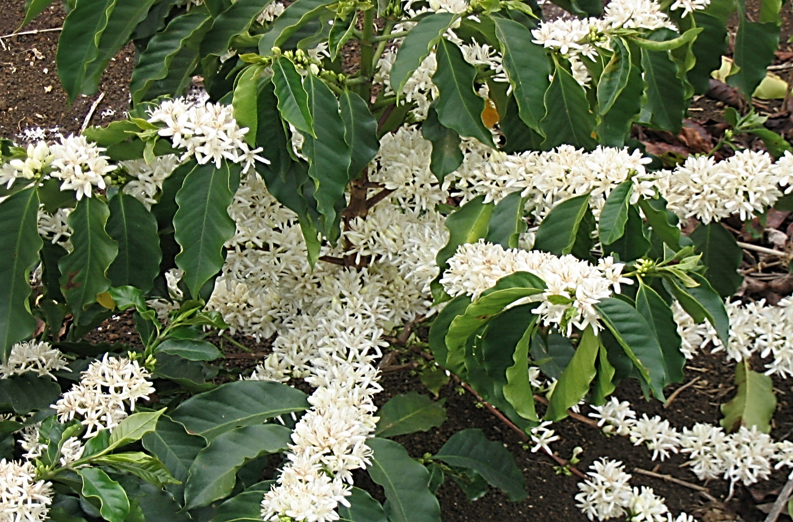
Belongs to genus Coffea
Two main commercially cultivated species
Coffea arabica
Coffea canephora
Fig. 1: White Flowers On Coffee Plant

Slide 6
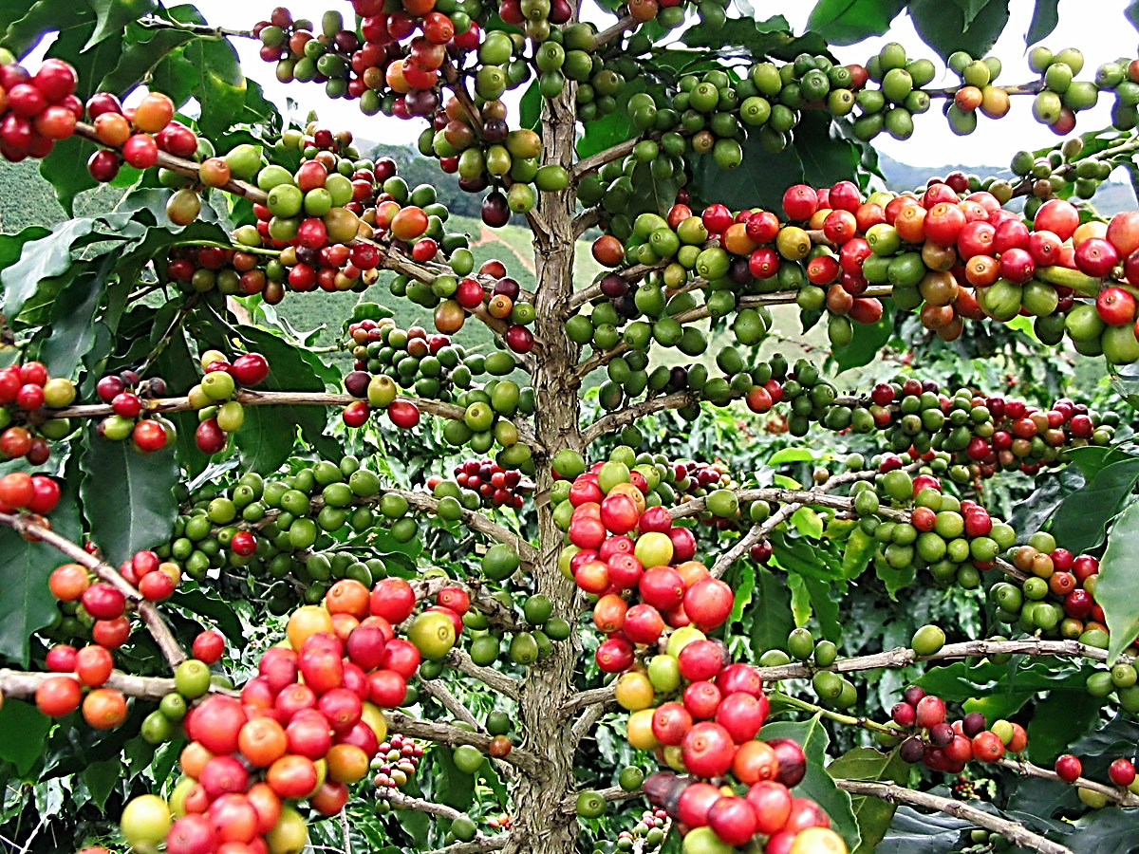
Coffea Plants evergreen Shrubs that may grow up to 15ft
Leaves are dark green & glossy, Length: 10-15cm & width: 6cm
Fig. 2: Coffee Plant with Berries

Slide 7

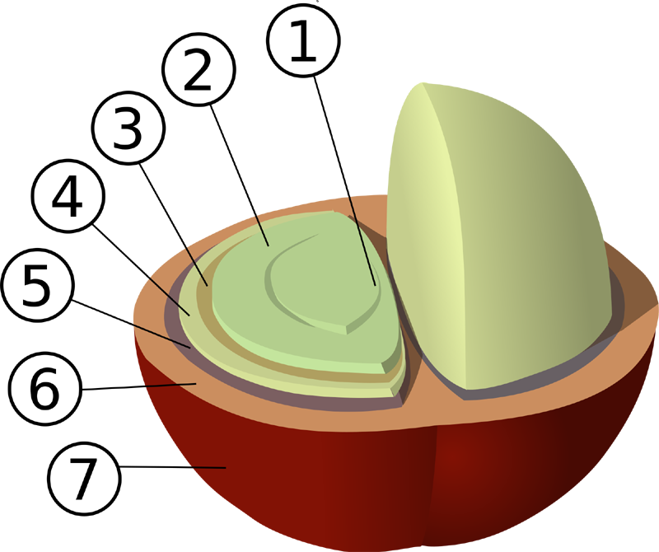
Centre Cut
Bean (Endosperm)
Silver skin (Epidermis)
Parchment Coat
Pectin Layer
Mesocarp
Outer Skin
Fig. 2: Coffee Berry

Slide 8
CHEMICAL COMPOSITION
Main Composition of Dried Green Coffee Beans are :
Non Volatile Alkaloids
Caffeine (1,3,7-trimethyl-xanthine) is the alkaloid most present in green & roasted coffee beans
Proteins & Amino Acids
Majority of the proteins are 11-S-storage proteins, Degrades under high temperature & oxygen
Fresh green coffee beans contains isoleucine , leucine , valine , tyrosine , phenylalanine
Carbohydrates & Lipids
Dominated by polysaccharides, such as arabinogalactan, galactomannan and cellulose.
Lipids found in green coffee include: linoleic acid, palmitic acid, oleic acid, stearic acid
Non Volatile Chlorogenic Acids
Chlorogenic acids compounds comprises caffeic acid, ferulic acid & 3,4-dimethoxycinnamic acid
Volatile Compounds

Slide 9
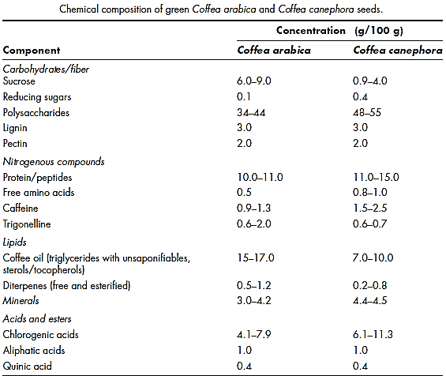
CHEMICAL COMPOSITION
Source: IFTPressBook_Coffee_PreviewChapter.pdf

Slide 10

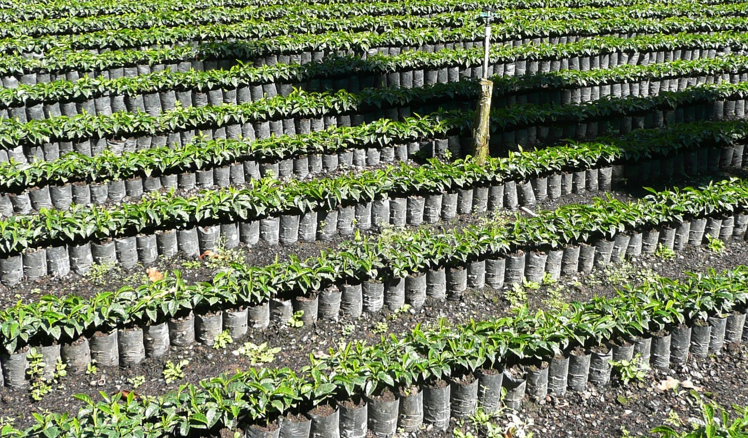


CULTIVATION
Climatic factors most important for coffee growth are temperature and rainfall
Temperatures between 73°F and 82°F (23°C and 28° C) are most favourable
Rainfall of 60 to 80 inches (1,500 to 2,000 millimetres) per year is required
Fig. 3: Coffee Nursery
Plantations are usually established in cleared forestland
Young shrubs grown in nurseries are planted in rows spaced
Plantation density varies between 500 and 750 plants per acre
Apart from disease control, Plant care is limited largely to trimming

Slide 11
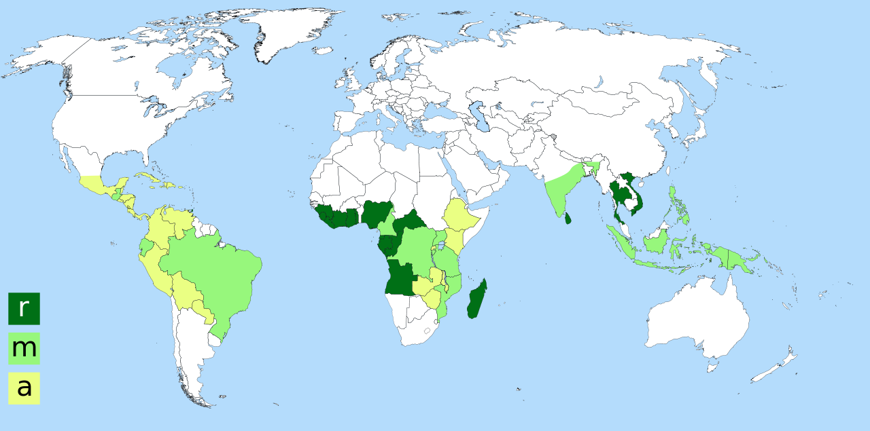
CULTIVATION
Fig. 4: Coffee Variety Around World
r: Coffea canephora
m: Coffea canephora & Coffea arabica
a: Coffea arabica

Slide 12
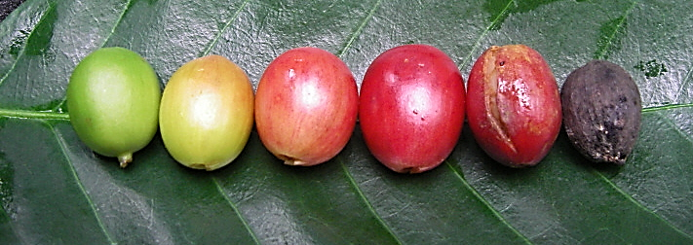
HARVESTING
:
Takes 3 or 4 years for the newly planted coffee trees to begin to bear fruit
Coffee cherry, turns a bright, deep red when it is ripe and ready to be harvested
Fig. 5: Coffee Cherry growth & ripening
Coffee Cherry is mostly picked by hand, Mechanised facility is also available
Whether picked by hand or by machine, all coffee is harvested in one of two ways:
Strip Picked
Selectively Picked

Slide 13
HARVESTING
STRIP PICKED
SELECTIVELY PICKED
Entire crop is harvested at one time
Crop is harvested in multiple rounds (8-10days)
All cherries are stripped off of the Branch
Selected cherries are stripped off of the Branch
Requires Less Labour Hours & Less Skill
Requires Skilled Labour & More Time
Results in mixed quality beans
Results in High quality beans
In most coffee-growing countries, there is one major harvest a year
Processing must begin as quickly as possible to prevent spoilage

Slide 14
PROCESSING
Depending on location and local resources, coffee is processed in one of two ways
Method of Processing
Dry Method
Wet Method
DRY METHOD
Simply Spread over and dried under Bright Sunlight
Racked & Turned throughout the day to facilitate drying
Drying continues for several weeks for each batch of coffee berries
Once Moisture Content Drops to 11%, Stored in airtight container

Slide 15
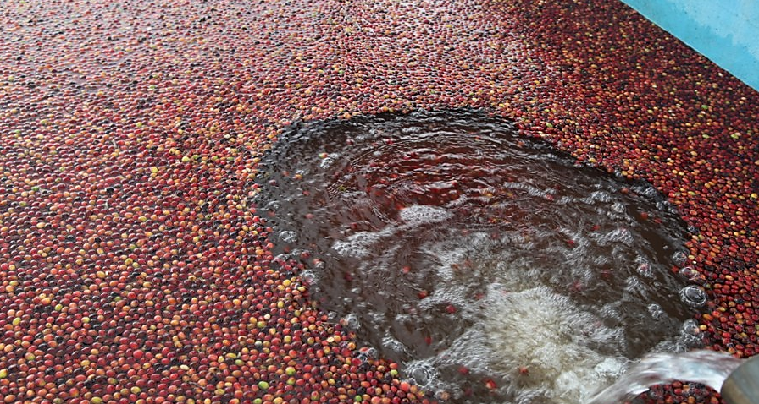
PROCESSING
WET METHOD
Fruit covering the seeds/beans is removed before they are dried
Pulping Machine separates the pulp & skin from the bean
Pulp is washed away with water & Water helps sorting
Fig. 6: Before Pulping

Slide 16
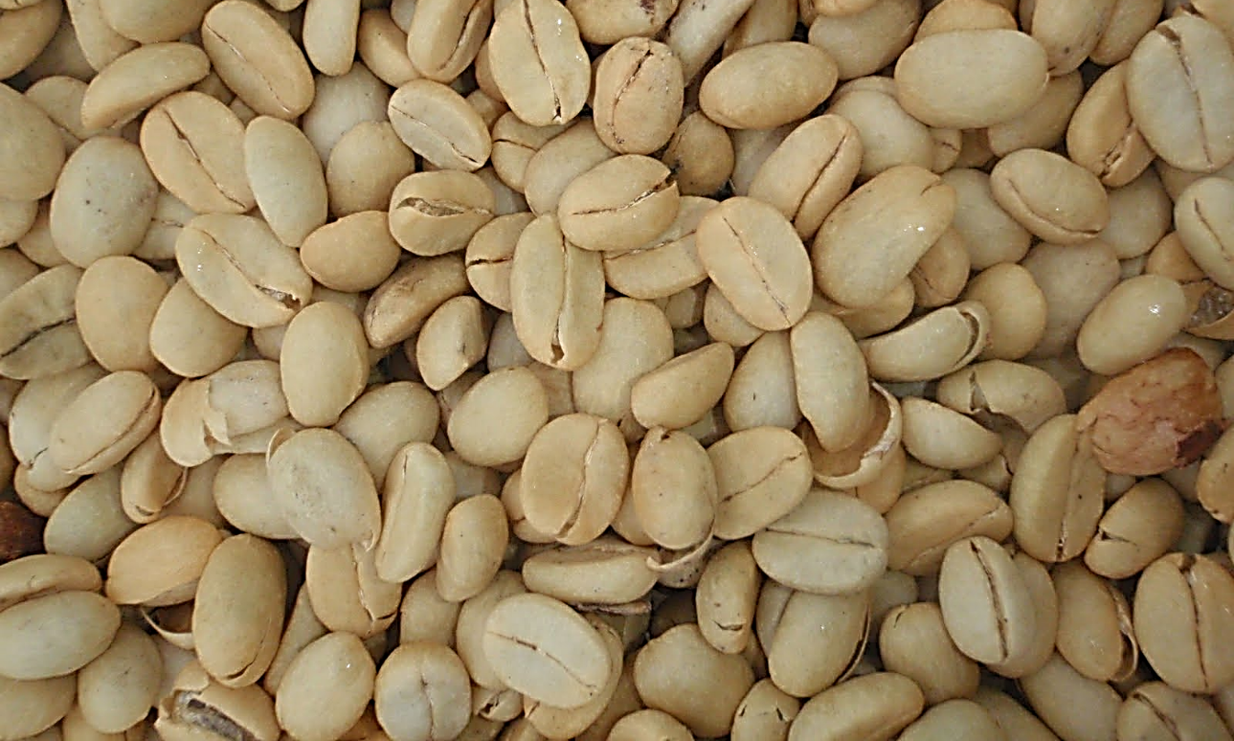
PROCESSING
WET METHOD
After Sorting, Beans are sent to fermentation tank (12-48hrs)
Purpose is to degrade the mucilage layer
Naturally occurring enzymes causes Mucilage layer to dissolve
After fermentation, Coffee Beans are dried up to 11% Moisture
Once dried this form of coffee is known as parchment coffee
Fig. 7: Coffee with Parchment Layer

Slide 17
MILLING
Parchment coffee is processed in the following manner:
HULLING
For wet processed coffee parchment layer is removed using machines
For dry processed coffee leathery fruit covering is removed by machines
POLISHING
This is an optional process, Removes Silver skin
Improves appearance & eliminate a by-product of roasting called chaff
SORTING & GRADING
Closely evaluated for colour flaws or other imperfections
This process is done by machine and hand
At this stage the coffee cherry/fruit is called green coffee beans

Slide 18
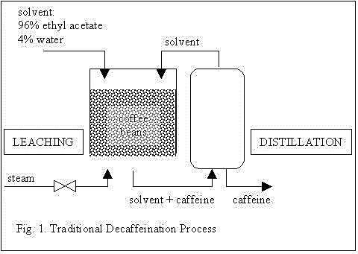
Green coffee beans are subjected to two optional process
AGING
Simply Brings in Changes in Flavour during Storage
DECAFFEINATION
Removes all most all caffeine from green coffee beans
Under European law decaffeinated coffee must contain 0.1% caffeine
Caffeine extraction from the green beans is done with a solvent or activated carbon
Source: http://www.metodolog.ru/

Slide 19

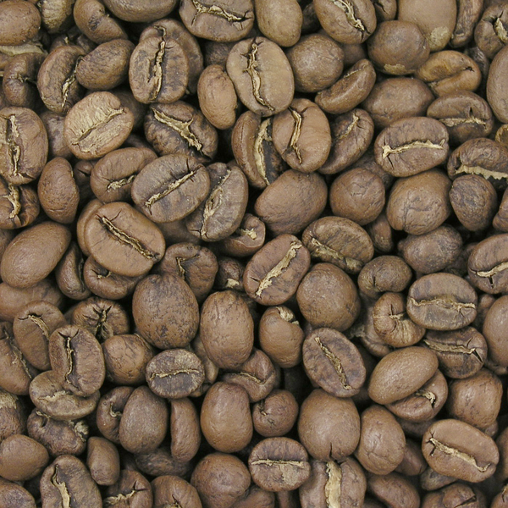
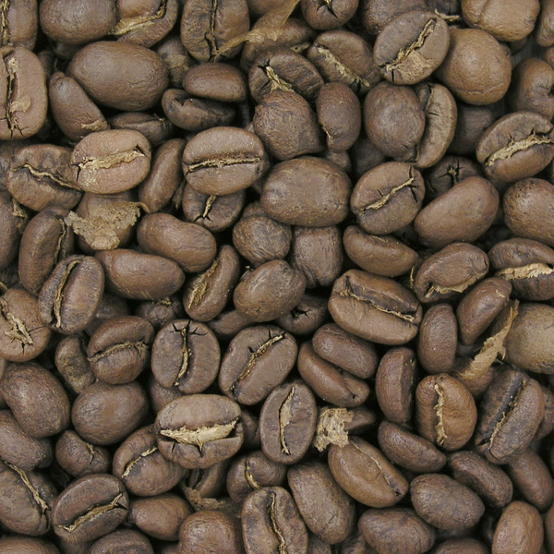
ROASTING
Roasting transforms green coffee into the aromatic brown beans
Roasting Develops Aroma & Flavor by pyrolysis
There are three types of roast
LIGHT ROAST
196 °C Cinnamon Roast
A very light roast level, immediately at first crack. Sweetness is underdeveloped, grassy flavour, and sharp acidity prominent.
205 °C Moderate-light Roast
Moderate light brown. A preferred roast for many specialty roasters, highlights origin characteristics as well as acidity.

Slide 20
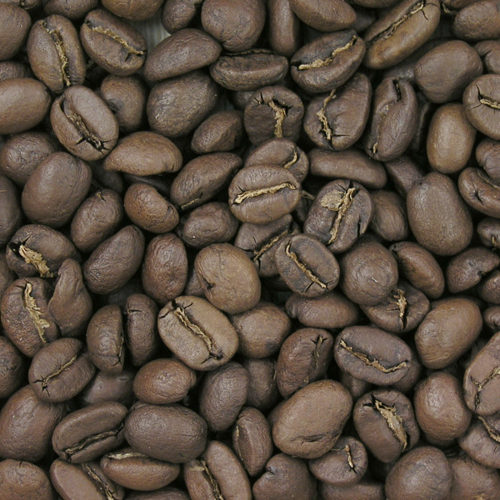
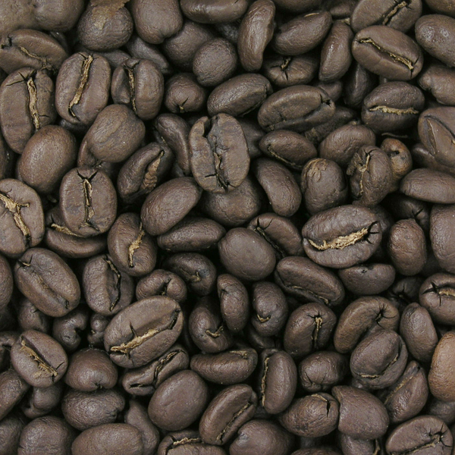
ROASTING
MEDIUM ROAST
210 °C American Roast
Medium light brown, developed during first crack. Acidity is slightly muted, but origin character is still preserved.
219 °C City Roast
Medium brown, common for most specialty coffee. Good for tasting the varietal character of a bean, although roast character is present

Slide 21
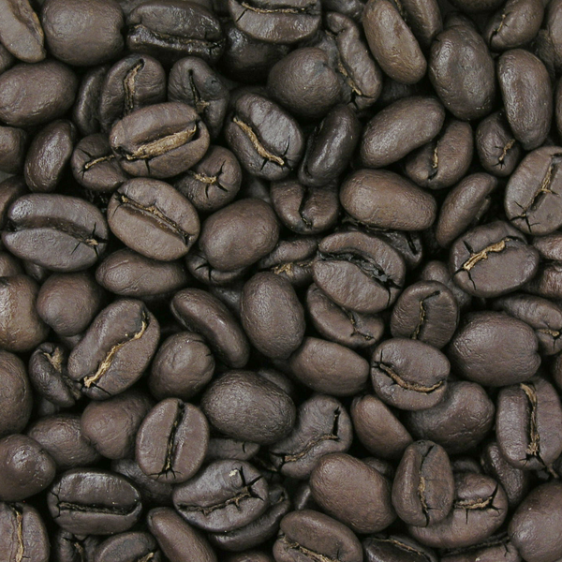
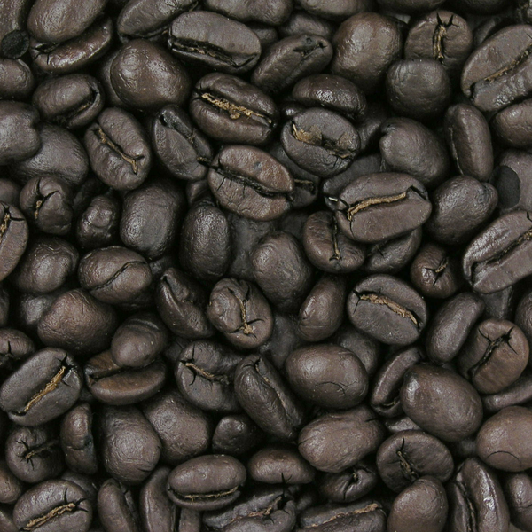
ROASTING
DARK ROAST
225 °C Full City Roast
Medium dark brown with occasional oil sheen, roast character is prominent. At the beginning of second crack. Any origin characteristics may be slightly present
230 °C Vienna Roast
Moderate dark brown with light surface oil, more bittersweet, caramel flavour, acidity muted. In the middle of second crack. Any origin characteristics absent

Slide 22
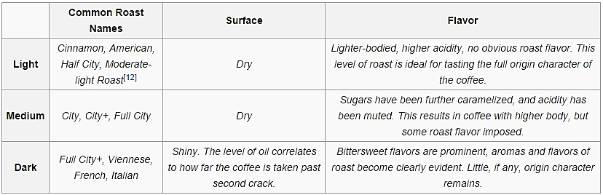
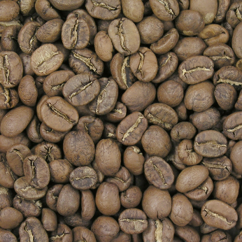


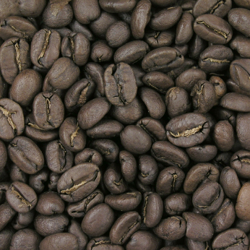

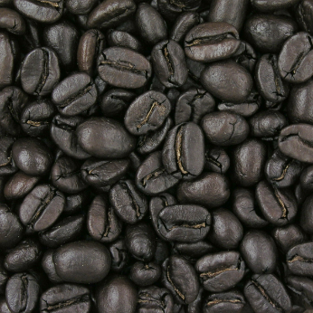
ROASTING SUMMARY

Slide 23
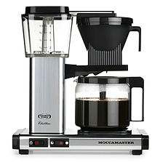
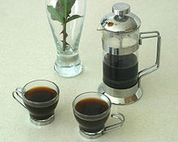
DIFFERENT COFFEE BEVERAGES
DRIP OR FILTERED COFFEE
Brewed by hot water passing slowly over roasted, ground coffee beans contained in a filter.
Water seeps through the ground coffee, absorbing its oils and essences, solely under gravity, then passes through the bottom of the filter.
FRENCH PRESS OR CAFETIE’RE
Also known as a press pot, coffee press, coffee plunger, cafetière (UK) or сafetière à piston, is a coffee brewing device patented by Italian designer Attilio Calimani in 1929.
Requires coffee of a coarser grind than does a drip brew coffee filter, as finer grounds will seep through the press filter and into the coffee.
It is brewed by placing the ground coffee in the empty beaker and adding hot (93-96 degrees Celsius) water, in proportions of about 28 grams of coffee to 450 ml of water, more or less to taste. After approximately four minutes the plunger is pressed to separate the grounds and hold them at the bottom of the beaker, then the coffee is poured.
An electrical drip brewer
A French press set and coffee

Slide 24
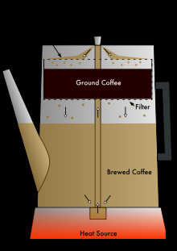
PERCOLATED
Here a pot (percolator) is used to brew coffee by
continually cycling the boiling or nearly-boiling brew
through the grounds using gravity until the required
strength is reached.
TURKISH COFFEE
It is a method of preparing unfiltered coffee.
Its preparation consists of immersing the coffee grounds in hot (but not continuously boiling) water for long enough to dissolve the flavorsome compounds.
In Turkey, four degrees of sweetness are used.
- sade (plain; no sugar)
-az şekerli (little sugar; half a level teaspoon of sugar)
-orta (medium sugar; one level teaspoon)
-şekerli (one and a half teaspoonful of sugar) and
-çok şekerli (a lot of sugar; for children).
The coffee and the desired amount of sugar are stirred until all coffee sinks and the sugar is dissolved. Following this, the spoon is removed and the pot is put on moderate heat
Diagram of a coffee percolator

Slide 25
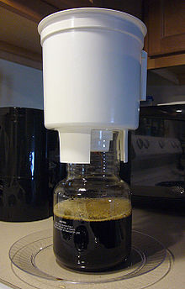
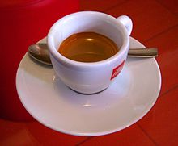
COLD BREW
Refers to the process of steeping coffee grounds in room temperature or cold water for an extended period.
Coarse-ground beans are soaked in water for a prolonged period of time, usually 12 hours or more, at room temperature, but chilled water can also be used.
The grounds must be filtered out of the water after they have been steeped using a paper coffee filter, a fine metal sieve, or a French press , which results in a coffee concentrate that is often diluted with water or milk, and can be served hot, over ice, or blended with ice and other ingredients such as chocolate.
ESPRESSO AND VARIATIONS
Espresso is brewed by using an espresso machine to force a small amount of nearly boiling water and steam - about 86 to 95 °C - under pressure through finely ground and compacted coffee.
It is generally denser than coffee brewed by other methods, having a higher concentration of suspended and dissolved solids.
It generally has a creamy foam on top termed "crema". It is the base for a number of other coffee drinks, such as latte, cappuccino, macchiato, mocha, and Americano.
Cold brew coffee system in action.

Slide 26
Caffè Americano : is a style of coffee prepared by adding hot water to espresso, giving a similar strength to but different flavor from regular drip coffee. The drink consists of a single or double-shot of espresso combined with between 30 - 470ml of hot water.
Café Cubano: it refers to an espresso shot which is sweetened with demerara sugar as it is being brewed.
Caffè crema: also known as “cream coffee" was the original term for modern espresso, produced by hot water under pressure, coined in 1948 by Gaggia to describe the light brown foam (crema) on espresso
Cafe Zorro :A Cafe Zorro is a double espresso, or doppio, added to hot water with a 1:1 ratio.
Doppio: Doppio in espresso is a double shot, extracted using a double filter basket in the portafilter.
Espresso Romano: An espresso Romano is a shot of espresso with a slice of lemon served on the side. The lemon can be run along the rim of the cup as a way to accentuate the espresso's sweetness.
Guillermo: Originally one or two shots of hot espresso, poured over slices of lime. It can also be served on ice, sometimes with a touch of milk
Ristretto: Ristretto is traditionally a short shot of espresso made with the normal amount of ground coffee but extracted with about half the amount of water

Slide 27
7.ESPRESSO WITH MILK:
It includes-
Antoccino: is a single shot of espresso with steamed milk in a 1:1 ratio, served in an espresso cup.
Breve: Espresso with half milk and half cream; size can vary - the name relates to the use of cream and milk.
Café bombón: espresso served with sweetened condensed milk in a 1:1 ratio.
Cappuccino: is a coffee-based drink prepared with espresso, hot milk, and steamed milk foam. A cappuccino usually exceeds the height of the cup, making the foam visible above the side of the cup.
Cortado: is an espresso with a small amount of warm milk to reduce the acidity. The ratio of milk to coffee is between 1:1 – 1:2.
Latte: is an espresso and steamed milk generally in a 1:3 to 1:5 ratio of espresso to milk, with a little foam on top.
Latte macchiato: means stained milk. This refers to the method of preparation, wherein the milk gets "stained" by the addition of espresso.
Espressino: is made from espresso, steamed milk, and cocoa powder.

Slide 28
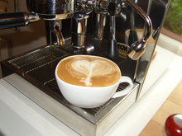
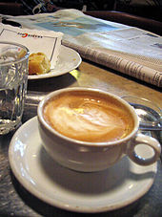
Flat white: is an espresso with a similar proportion of coffee to milk as a latte and a cappuccino, the main difference being the texture of the milk and (in some regions) the number of espresso shots.
Galão: Galão is a hot drink from Portugal made of espresso and foamed milk, it comes in a tall glass with plenty of milk.
Macchiato: Macchiato, meaning "stained", is an espresso with a dash of foamed milk. At first sight it resembles a small cappuccino, but even if the ingredients are the same as those used for cappuccino, a macchiato has a much stronger and aromatic taste. The milk is foamed directly into the espresso cup, which is then put under the coffee outlet. The espresso is then drawn into the cup. Cocoa is sometimes sprinkled over the drink. Often the process is reversed and milk foam is floated on top of extracted coffee.
Wiener or Viennese melange: A Wiener Melange is a specialty coffee drink similar to a cappuccino.
A flat white with latte art
A Wiener melange

Slide 29
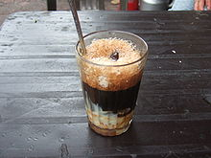
8.COFFEE WITH MILK
Café au lait: café au lait is defined as a coffee drink consisting strong or bold coffee (sometimes espresso) mixed with scalded milk in approximately a 1:1 ratio
Ca phe sua da: is a unique Vietnamese coffee recipe. Literally, Ca phe sua da means "iced milk coffee". Ca phe sua da can be made simply by mixing black coffee with about a quarter to a half as much sweetened condensed milk and then pouring it over ice.
Egg coffee: Egg coffee is a Vietnamese drink which is traditionally prepared with egg yolks, sugar, condensed milk and Robusta coffee.
Eggnog latte: An autumn and winter seasonal blend of steamed milk and eggnog, plus espresso and a pinch of nutmeg.
Eiskaffee: Eiskaffee, literally "ice cream coffee", is a popular German drink consisting of chilled coffee, milk, vanilla ice cream, and sometimes sugar and/or whipped cream.
Kopi susu: can be made simply by mixing black coffee (Arabica) with about a quarter to half a glass of sweetened condensed milk then let stand to cool and allow the grounds to sink to the bottom.
White coffee: The coffee beans are roasted with palm-oil margarine, and the resulting coffee is served with condensed milk. The taste is smooth and sweet, and is often served iced.
A Cà phê sữa đá

Slide 30
9.COFFEE OR ESPRESSO WITH WHIPPED CREAM
Vienna coffee: A Vienna coffee is coffee or espresso topped with whipped cream. Milk is sometimes poured into the coffee/espresso before adding the whipped cream. Vanilla, chocolate or cinnamon is sometimes sprinkled on the cream.
Espresso con panna: Espresso con panna is coffee with whipped cream.
10.COMBINATIONS
Coffee with espresso: Regular coffee (slow brewed as with a filter or cafetière) is sometimes combined with espresso to increase intensity of flavor and/or caffeine.
Coffee with tea:
Black tie: is a traditional Thai iced tea, which is a spicy and sweet mixture of chilled black tea, orange blossom water, star anise, crushed tamarind, sugar and condensed milk or cream, with a double shot of espresso.
Chai latte: Chai tea with a single shot of espresso. In addition, 1-2 tablespoons of instant espresso may be brewed while simultaneously steeping Chai in the same container; a small amount of a dairy or non-dairy drink of choice is usually added to complete the drink.
Red tie: A traditional Thai iced tea, which is a spicy and sweet mixture of chilled black tea, orange blossom water, star anise, crushed tamarind, sugar and condensed milk or cream, with a single shot of espresso.
Yuanyang: is a popular drink in Hong Kong, made of a mixture of coffee and Hong Kong-style milk tea

Slide 31
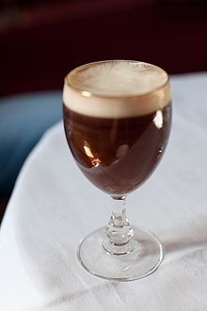
Coffee with alcohol:
Liqueur coffee: is a coffee brew with a 25 ml shot of liqueur. This brew is usually served in a clear, clean, pre-heated, liqueur coffee glass with the coffee and cream separated for good visual and taste effect. The liqueur of choice is added first with a teaspoon of raw cane sugar mixed in. The glass is then filled to within an inch of the top with good, strong, fresh filter coffee. Fresh, chilled, additive free, slightly whipped cream is then poured carefully over the back of a cold teaspoon, so that it floats on top of the coffee and liqueur mixture. The sugar is required in the coffee mixture to help the cream float.
Irish coffee: is coffee combined with whiskey and cream, often further sweetened with sugar. Also available as a flavor of ice cream.
Rüdesheimer Kaffee: is an alcoholic coffee drink from Rüdesheim in Germany invented in 1957 by Hans Karl Adam. It is made with Asbach Uralt brandy with coffee and sugar, and is topped with whipped cream.
Pharisäer: meaning a Pharisee, is an alcoholic coffee drink that is popular in the Nordfriesland district of Germany. It consists of a mug of black coffee, a double shot of rum, and a topping of whipped cream.
Irish coffee

Slide 32
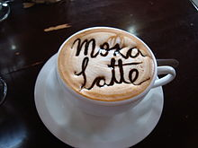
11 FLAVOURED COFFEE
Melya: is coffee flavoured with cocoa powder and honey. Cream is sometimes added.
Caffè Marocchino: is made from espresso, steamed milk, and a dusting of cocoa powder, similar to the Espressino.
Café miel: A café miel has a shot of espresso, steamed milk, cinnamon, and honey. The name comes from the French word for honey, miel.
Mocha or café mocha: is a variant of a Caffè latte. Like a latte, it is typically one third espresso and two thirds steamed milk, but a portion of chocolate is added, typically in the form of a chocolate syrup, although other vending systems use instant chocolate powder. Mochas can contain dark or milk chocolate.
Café de olla: also known as pot coffee is a traditional coffee-based drink prepared using earthen clay pots or jars in Mexico and other Latin American countries. It is flavored with cinnamon and piloncillo.
A mocha latte

Slide 33
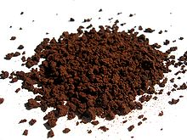
12.Iced coffee: Iced coffee is a cold variant of coffee.
13 Instant coffee: Instant coffee is a drink derived from brewed coffee beans. Through various manufacturing processes the coffee is dehydrated into the form of powder or granules. These can be rehydrated with hot water to provide a drink similar (though not identical) to conventional coffee.
14 Decaffeinated Coffee: A decaffeination process removes caffeine from coffee beans to lower the caffeine content.
Besides the other types are:
15 Others
Affogato
Coffee milk
Caffè Medici
Café Touba
Indian filter coffee
Moka
Pocillo
Instant coffee

