Slide 1
TOPIC : NMR
FOR CLASS 6TH SEMESTER
PRESENTED BY
DR. K.K.BORAH
ASSOCIATE PROFESSOR,
DEPT OF CHEMISTRY, MANGALDAI COLLEGE

Slide 2
Nuclear Magnetic Resonance

Slide 3
NMR : Powerful device for locating positions of nuclei
In 1945, Discovered by
Purcell, Torrey and Pound at Harvard
Bloch, Hansen, Packard at Stanford
Nobel Prize
EtOH : first compound studied

Slide 4
¹HNMR : absorption spectroscopy, radiations in Radio Frequency region are absorbed
Nuclei posses intrinsic spin and have angular momentum .
h
[I(I+1)]
2π
I = 0, 1/2, 1, 3/2, ----etc
Nucleus : charged body
Charged & spinning body generates magnetic dipole.
Condition: I > 0
Magnetic dipole has nuclear magnetic moment μ.
In external magnetic field Ho, angular momentum is
quantized : (2І + 1) orientations

Slide 5
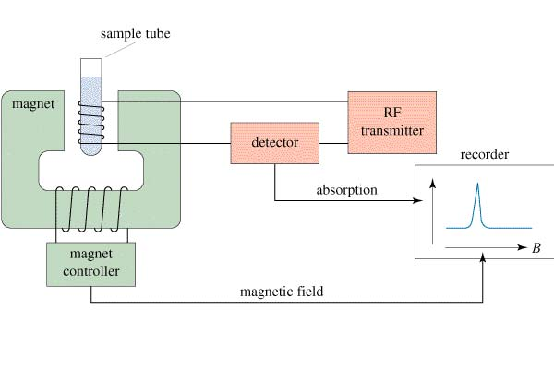
The NMR Spectrometer

Slide 6
Applications of nuclear magnetic resonance
Spectroscopy in organic chemistry
Spin No I > 0
¹H I = 1/2 ³¹P I = ½
¹⁹ F I = 1/2 ¹³C I =1/2
For organic molecules : ¹HMR and ¹³C NMR
-1/2
E
I = 1/2
υ = 2μHo
h
+1/2
Ho
Interpretation of the spectrum
1. Integration 2. chemical shift
3. Spin Spin Coupling 4. Rate processes

Slide 7
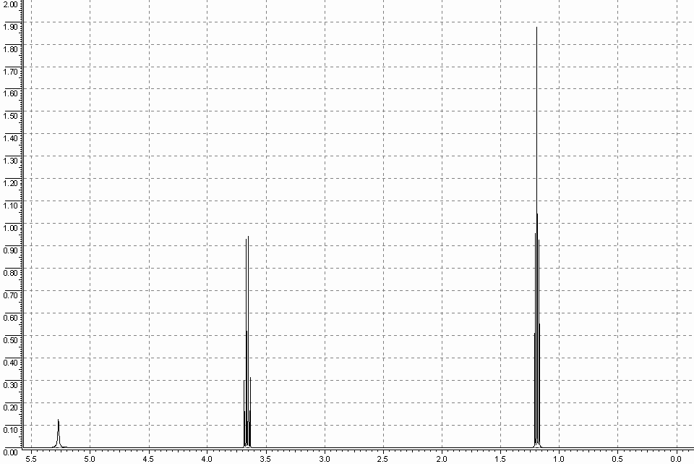
6mm : 3 protons
4mm : 2proton
2mm: 1proton
Area under the peak = no. of nuclei/ protons absorbing at that place
Area under the peak is directly converted to heights electronically .
OH – CH₂- CH₃
2mm 4mm 6mm
2 : 4 : 6
1 : 2 : 3

Slide 8
Chemical Shift
CH₃
CH₂
OH
υ = γ Ho/ 2π
H₁ = Ho (1-σ) σ- shielding constant
Ho- applied mag. field.
H₁ – field felt at the nucleus
σ- molecular structure. Chemical environment
Electron withdrawer – nucleus becomes bare - deshielding
Electron Donor - shielding

Slide 9
TMS – Tetra methyl silane
Most up field Singlet
Chemical shift – Position of the peak from TMS
Units of chemical Shift: Hertz or cps
Chemical shift α Ho
δ is used
δ =
Τ =10 – δ
tau
signal in Hz x 10⁶
oscillator freq. in Hz

Slide 10
Some useful δ values
1. R CH₃ 0.9 increase in 4. R- CH₂І 3.2 Electro negativity
R-CH₂-R 1.3 substituents R-CH₂-Br 3.5 increases
R-CH-R 2.0 increases δ R-CH₂-Cl 3.7 δ increases
R
2. CH₃-OH 3.38 5. C-CH₃ 0.9 electro-negativity
CH₃-COR 3.36 N-CH₃ 2.5 increases
CH₃OR 3.30 O-CH₃ 3.3 δ increases
3.
1.67
6.
2.5
5.3
2.00
7.3
2.3
R-CHO
9.7

Slide 11
N- H
S- H
O- H
Chemical shift varies with solvent, conc., temp etc

Slide 12
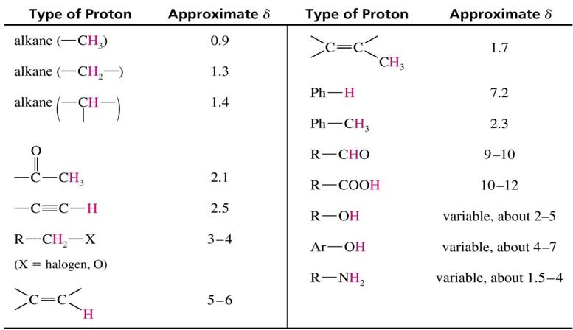
TMS
Up field
Down field
Shielded
Deshielded

Slide 13
How many types of protons
CH₃-CH₂- S- CH₃
a b c
a – 0.9
b – downfield due to S
c - downfield due to S
Four types
a and d -Cl more electronegative
d more down field than a.
b – downfield due to CHO than 2.0δ
c - most down field
a
c
b
d
Two types
Ha – 7.42 deshielded due to Oxygen
Hb – 6.37

Slide 14
Spin spin coupling
Geminal coupling
Vicinal coupling
Long range coupling

Slide 15
a. Geminal or 1,3 coupling
b. Vicinal or 1, 4 coupling
c. Long range or 1,5 or more coupling
H-C-C-H
Coupling const. J : Distance between two lines
J is not depend on Ho Mutually coupled protons, same J value
Chemically equivalent protons do not couple with each other .
e.g.
-J-
CH₃ - equivalent
Hence do not couple

Slide 16
Spin spin Coupling
First order Analysis . Chemical shift: centre of the signal
Multiplicity= (2n_{a}І_{a} +1) (2n_{b}І_{b}+1) (2n_{c}І_{c} +1)------
n_{a}, n_{b}, n_{c}- different no. of nonequivalent partners
І_{a}, І_{b}, І_{c} – spin number of the coupling nucleus
For ¹HNMR
Multiplicity = (n_{a} + 1) (n_{b} + 1)(n_{c} + 1) ----------
e.g. H₃C-CH₂-CH₂-CH₃ For a – (2 +1) – triplet
a b b – (3 +1)- quartet
c
a – (1 + 1) doublet
b – (3 + 1) (2 + 1) – 4 x 3 – 12 lines
c – (1 + 1) doublet
a
b

Slide 17
H_{a} – (1 +1) (1 +1) – 2 x 2 – doublet of doublet dd
H_{b} – (1 +1) (1 +1) - 4 lines –dd
H_{c} - (1 +1) (1 +1) (3 + 1) – 2 x 2 x 4 – 16 lines ddq
H_{b} with CH₃ - Long range coupling allylic coupling
very small J.
Not normally seen

Slide 18
Spin spin coupling
1
1
3
3
1
2
Ho
Ho
Unperturbed
signal
1
Triplet
1 : 2 : 1
Quartet
1 : 3 : 3 : 1 intensity ratio
J
J

Slide 19
Spin spin coupling
Intensity ratio of the multiplet
Ratio of coefficient of the binominal expression
( X + 1)^{n} is the intensity ratio
e.g. n = 1 n is no. of coupling partners
(X + 1)¹ = X + 1
Coefficient ratio is 1 : 1
Doublet with 1 : 1 intensity ratio
line position : δ value 3.7
3.7 x 90 = 333 Hz
J = 6 Hz
333
J
1 : 1
336
J
330

Slide 20
When n =2
(x + 1)² = x² + 2x + 1
Coefficient ratio is 1 : 2 : 1
Triplet with 1 : 2 : 1 intensity ratio
δ – 3.4
3.4 x 90 = 306 Hz
J = 7 Hz
306
313
J
299
J
1
1
2

Slide 21
M F : C₃H₆O
1 HNMR – 2.72 δ (quintet , J = 6 Hz 12mm) 2H
4.73 δ (triplet J = 6 Hz 23.5mm) 4H
Deduce the structure . Find intensities of lines signals.
Integration ratio
12 : 23.5 = 12 : 24 = 1 : 2
Total no. of protons are 6 = 2 : 4
Four protons (a) as triplet
Partner is CH₂
CH₂-CH₂-CH₂
a b a
High strength instruments are preferred why ?

Slide 22
Br- CH₂- CH₂-CH₂-І
a b c
2.27 (quintet , H_{b} J = 7Hz), 3.55(triplet, H_{c} J = 7Hz)
3.70(triplet, H_{a}, J = 7Hz)
Find first line position on 40 MHz
3.7 x 40 = 148Hz 3.55 x 40 = 142Hz
2.27 x 40 = 90.8=91Hz

Slide 23
148
142
222
213
814
781
40MHz
60MHz
220MHz
155 148 141 149 142 135 229 222 215 220 213 206 821 814 807 788 7 81 774
148
142
222
213
814
7 81
155
141
135
229
220
206
821
807
788
7 81
149
215

Slide 24
When J is same no. of lines are reduced (J =7 Hz)
Expected lines (2 + 1) (2 + 1)= 3 x 3 = 9 lines
91Hz
91Hz
98Hz
84Hz
98Hz
84Hz
98 91 84 77
1 : 4 : 6 : 4 : 1
105 98 91 98 91 84 91 84 77

Slide 25
Rate Processes
Chemical Exchange
Acidic protons like O-H, N-H show Chemical Exchange
e.g. CH₃CH₂OH
Normal
sample
Rate of exchange = rate of spin spin coupling
Line broadening
Pure Rate of exchange very less than rate
of coupling, no exchange, coupling
Ethanol seen
Ethanol Rate of exchange more than rate of
coupling,
+ 1 drop acid Fast exchange, no coupling
Or base

Slide 26
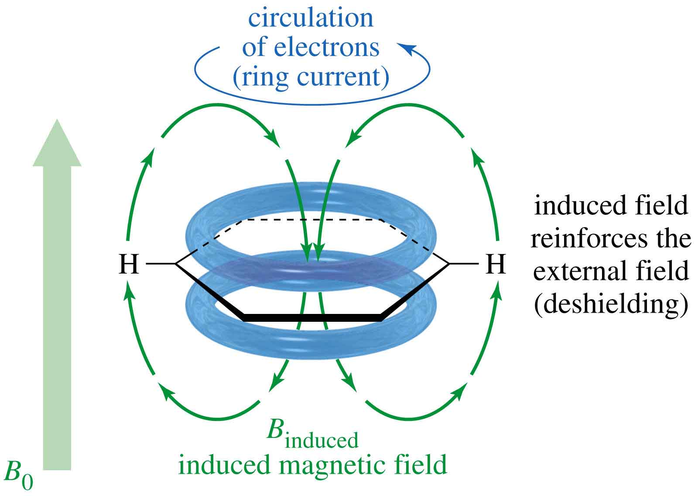
Aromatic Protons, 7-8 δ

Slide 27
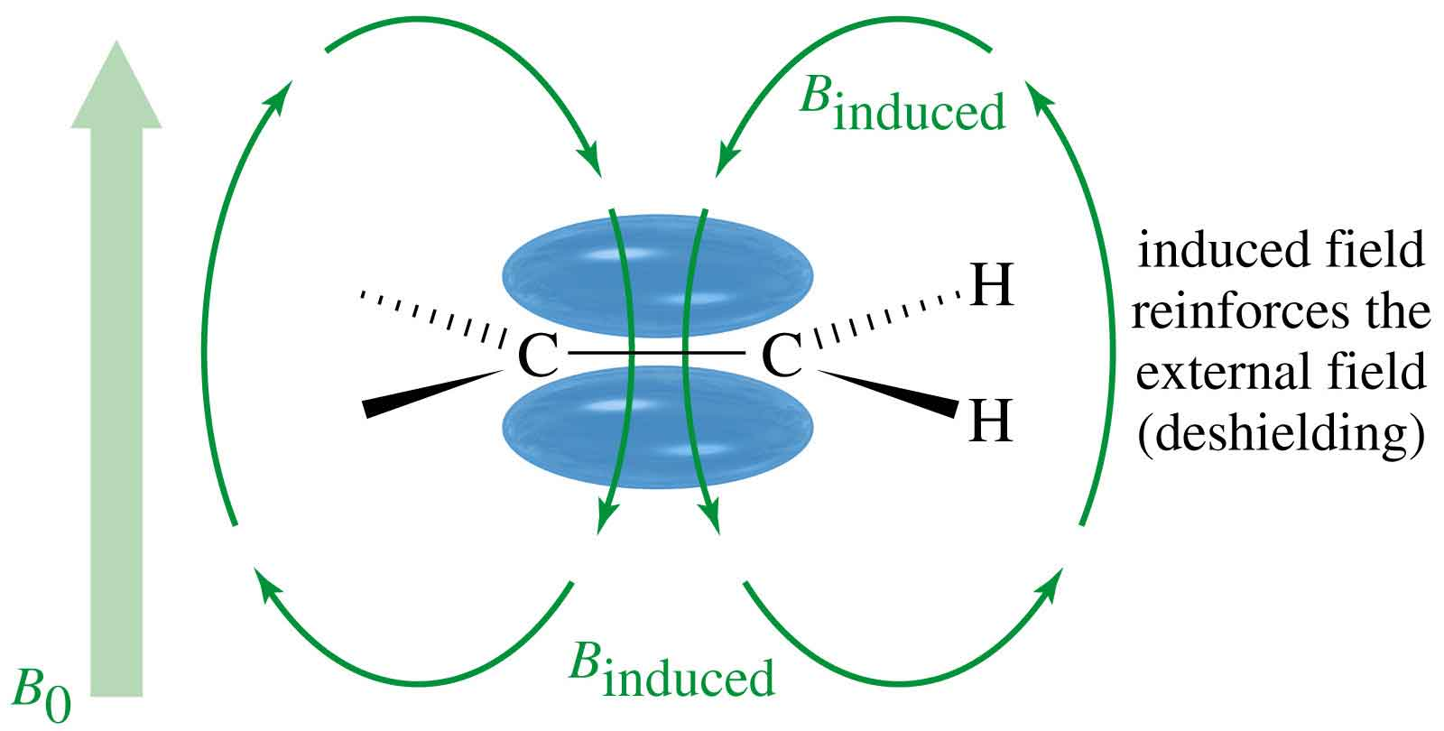
Vinyl Protons, δ5-δ6

Slide 28
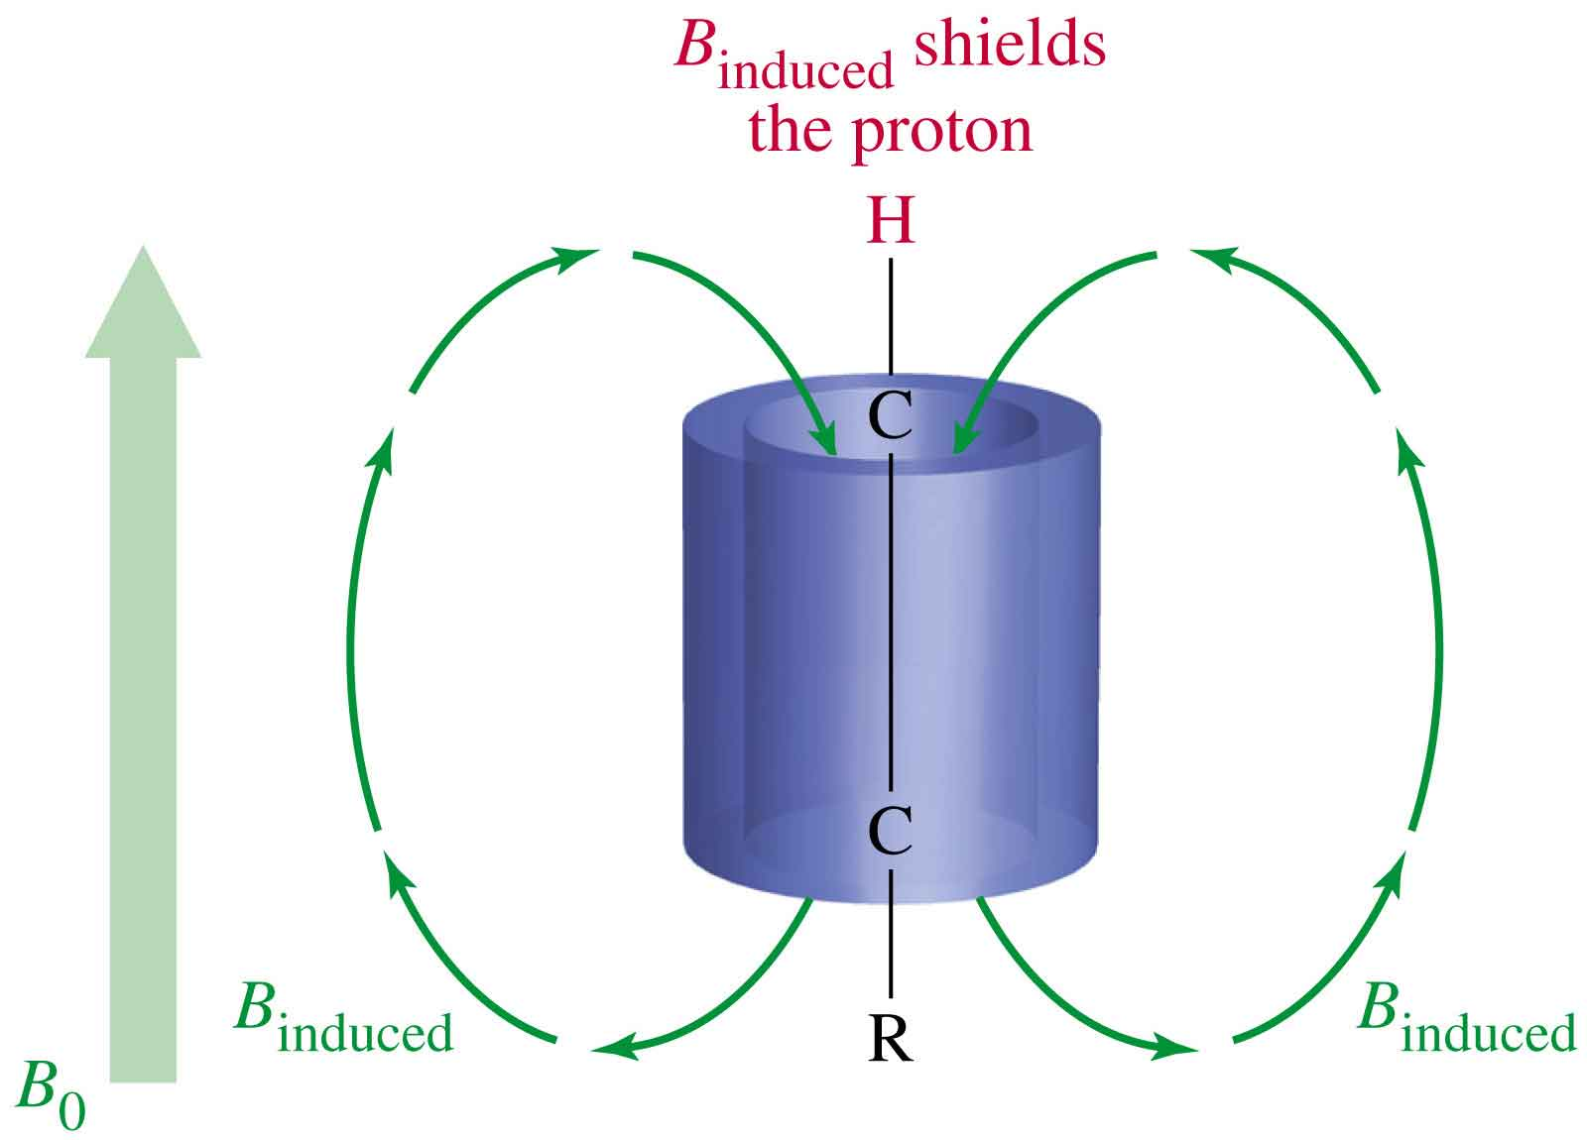
Acetylenic Protons, δ2.5

Slide 29
9.28δ
At -60 ºC
-2.99δ
At 110 ºC – single line
at 5.45 δ

Slide 30
Aromatic Protons 6.5 to 8.0 due to ring current effect
7.25
6.5δ
7.14 δ
6.87 δ
Withdrawer
8.26 δ
Electron withdrawer
o and p downfield
m less downfield
7.57 δ
7.69 δ

Slide 31
Aromatic Protons Coupling
4 lines dd
o, m coupling
Ortho – 8Hz
Meta - 2Hz
Para - 1Hz
4 lines dd
Two ortho
(2 +1) (2 + 1) = 3 x 3 = 9 lines t,t

Slide 32
singlet
6.7 – 6.8 d
7.0 – 8.0 d
8.0 6.8
Shielded o coupled
Less deshielded
o, m coupled
m coupled d
more down field

Slide 33
3.8 (s, 6mm)
6.3 (d, J = 10Hz, 2mm)
6.7 (d, J = 2Hz , 2mm)
6.9 (dd, J = 8, 2 Hz, 2mm)
7.3 (d, J = 10 Hz, 2mm)
8.1 (d, J = 8 Hz, 2mm)

Slide 34
¹⁹ F І = 1/2
J_{HF} = 8Hz
¹H d q ¹⁹F
dq
dt
J_{HF} = 45Hz
J_{FF} = 15 Hz
tq

Slide 35
Advanced NMR Techniques
Use of Shift Reagents
Spin Spin Decoupling Experiments
nOe Experiments
Two Dimensional NMR

Slide 36
Use of Shift Reagents
Introduced in 1969
Use for spreading out the NMR with out increasing
the strength Ho.
Ions of Rare earths –Lanthanides coordinated to Organic
ligands.
Complex is formed with the functional group of the substrate.
Chemical Shift is changed.
Signals shifted and can be identified easily.
Eu(dpm)₃, Eu(fod)₃

Slide 37
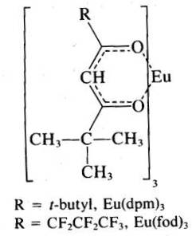
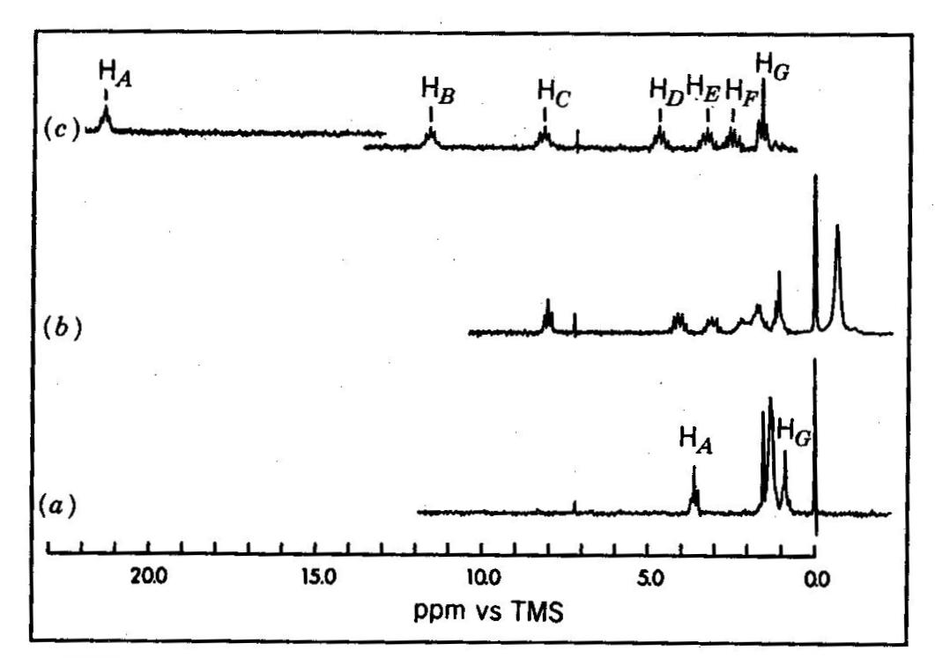
60 MHz NMR Spectra of
1-Heptanaol using Eu(dpm)₃

Slide 38
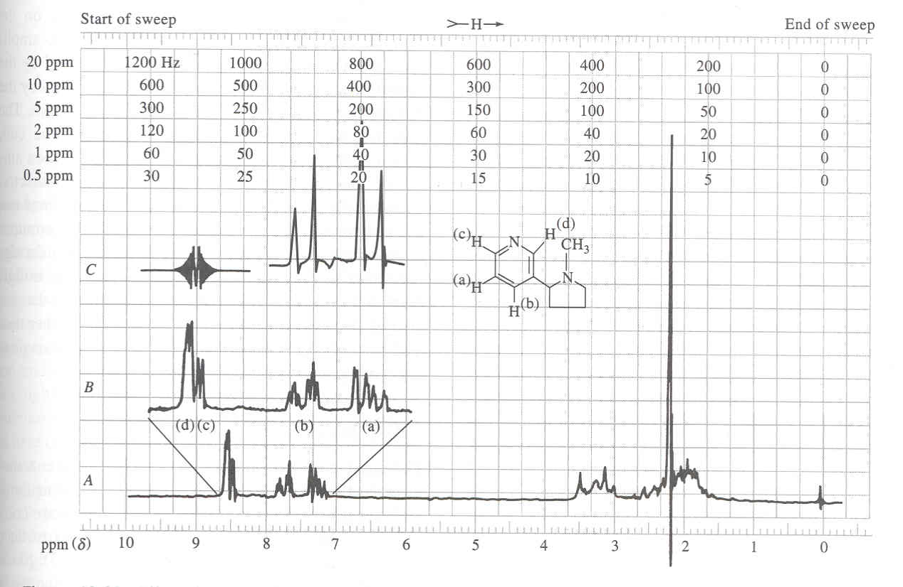
Example of Double Resonance Techniques
Spin-Spin Decoupling

Slide 39
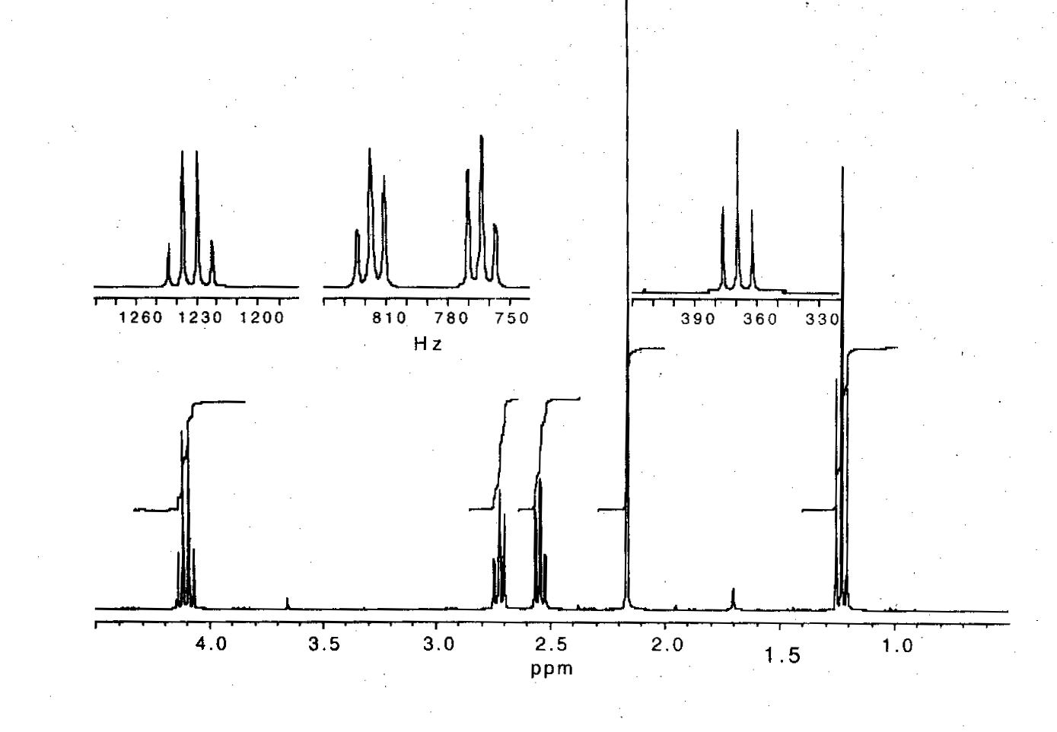
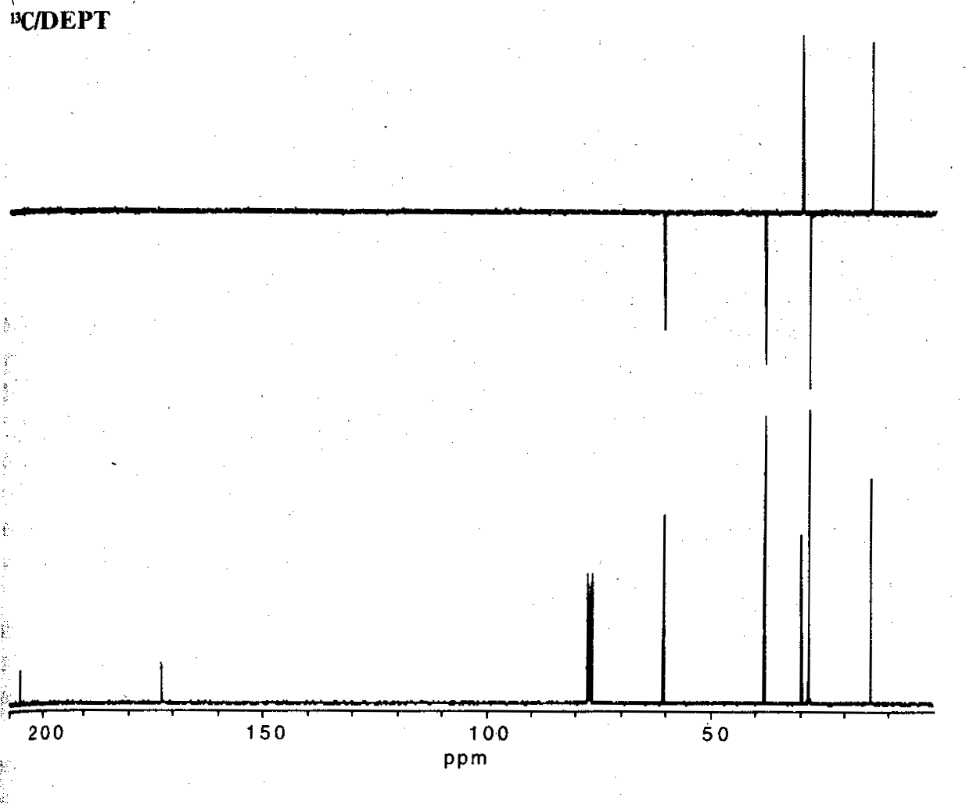
Ethyl levulinate
M F = C₇H₁₂O₃
IR = 1725 cm⁻¹
Distortionless
Enhancement
By Polarization
Transfer
DEPT

Slide 40
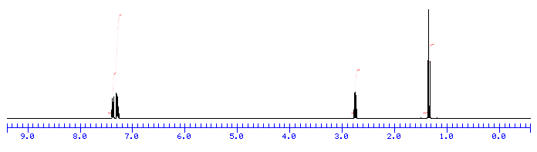

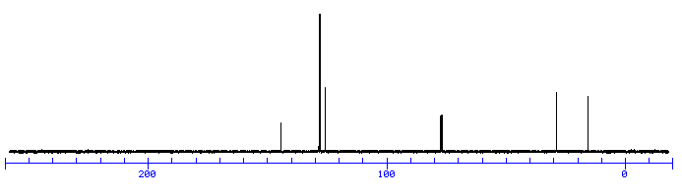
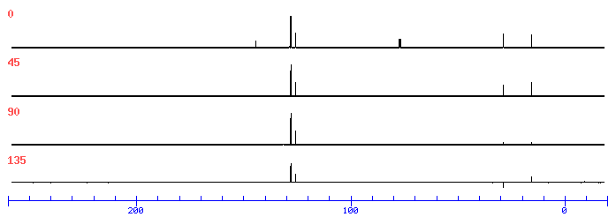
¹H NMR Spectrum - C₈H₁₀
Ethyl benzene
¹³C NMR Spectrum
DEPT Spectra

Slide 41
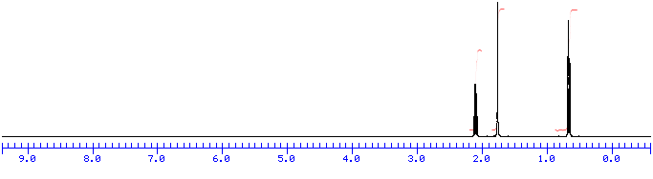

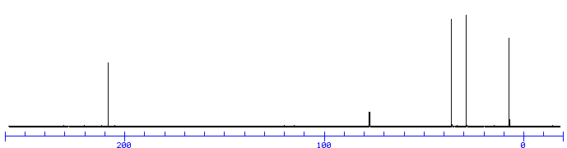
¹H NMR Spectrum - C₄H₈O
methyl ethyl ketone
2-butanone
¹³C NMR Spectrum

Slide 42
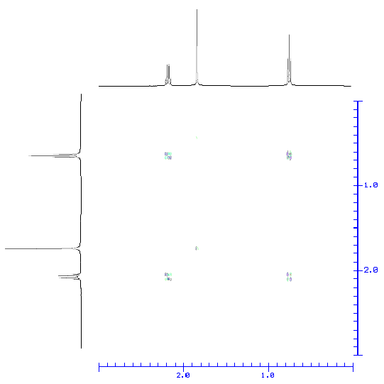
COSY Spectrum : COrrelation SpectroscopY

Slide 43
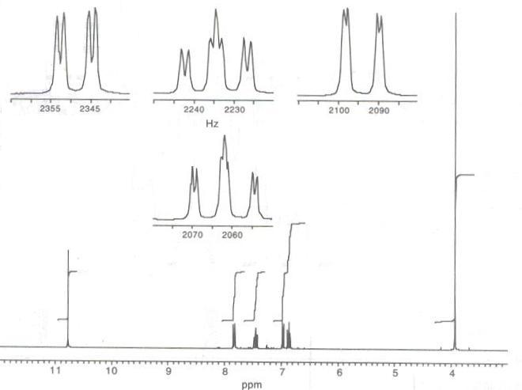

Slide 44
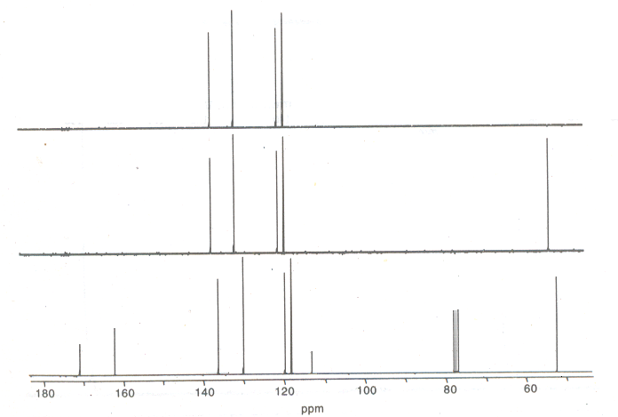

Slide 45
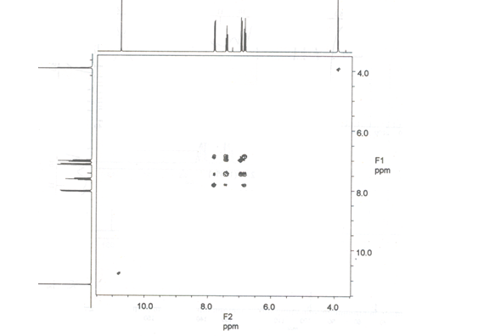

Slide 46
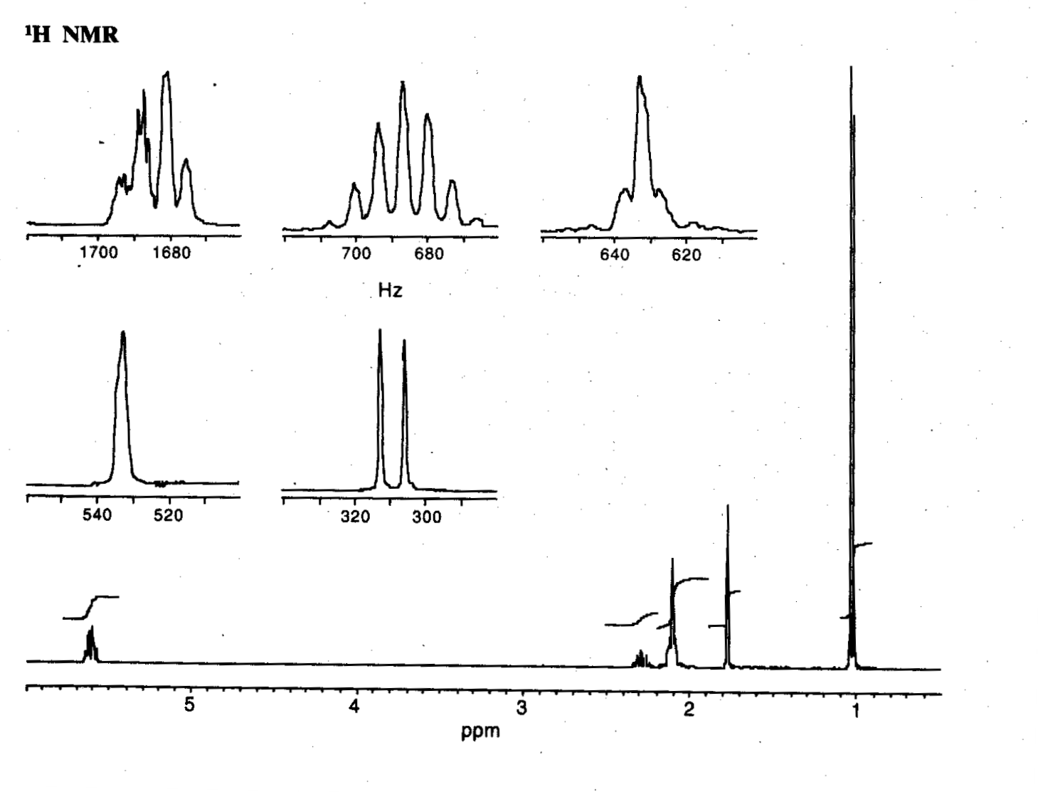
M F = C₁₀H₁₆

Slide 47
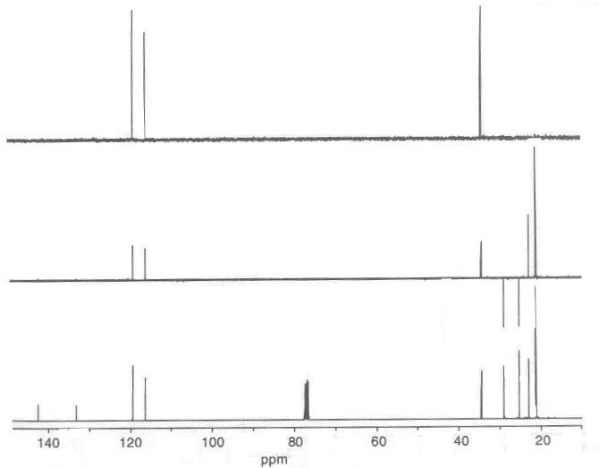

Slide 48
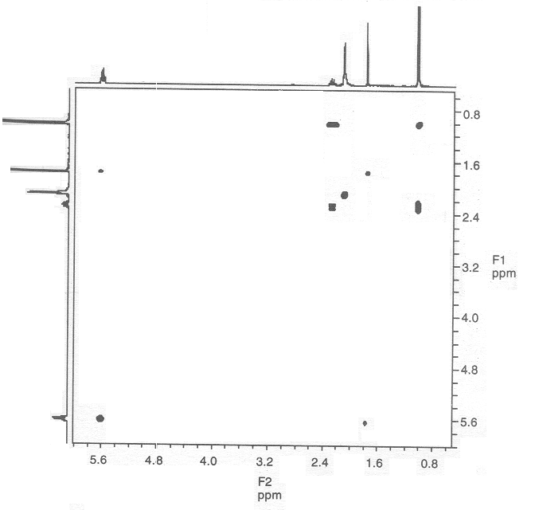

Slide 49
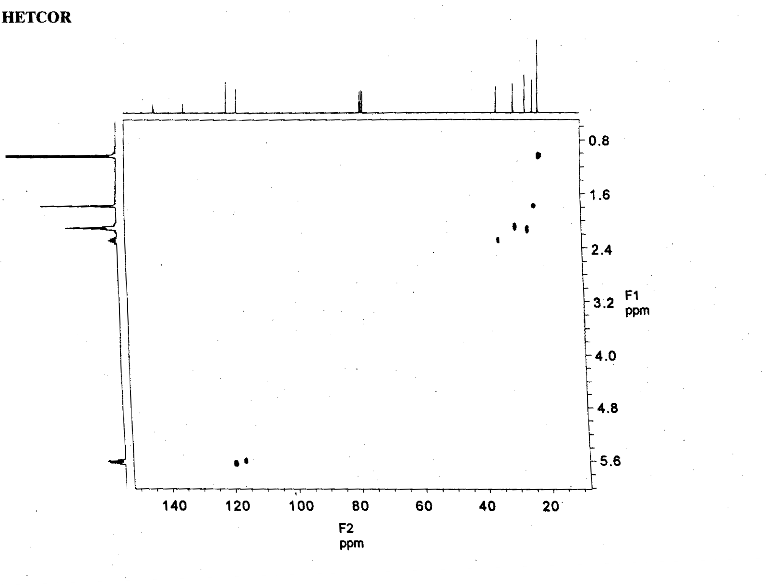
HETCOR : HETeronuclear chemical shift COrelation

Slide 50
Thank You

